Slide 1
[E]lectro[M]agnetic [C]ompatibility BASICS
Stiliyan Filipov, 09-MAY-2023
Now… this is what will happen to your designs in real life!
Notes:
SF

Slide 2


Slide 3
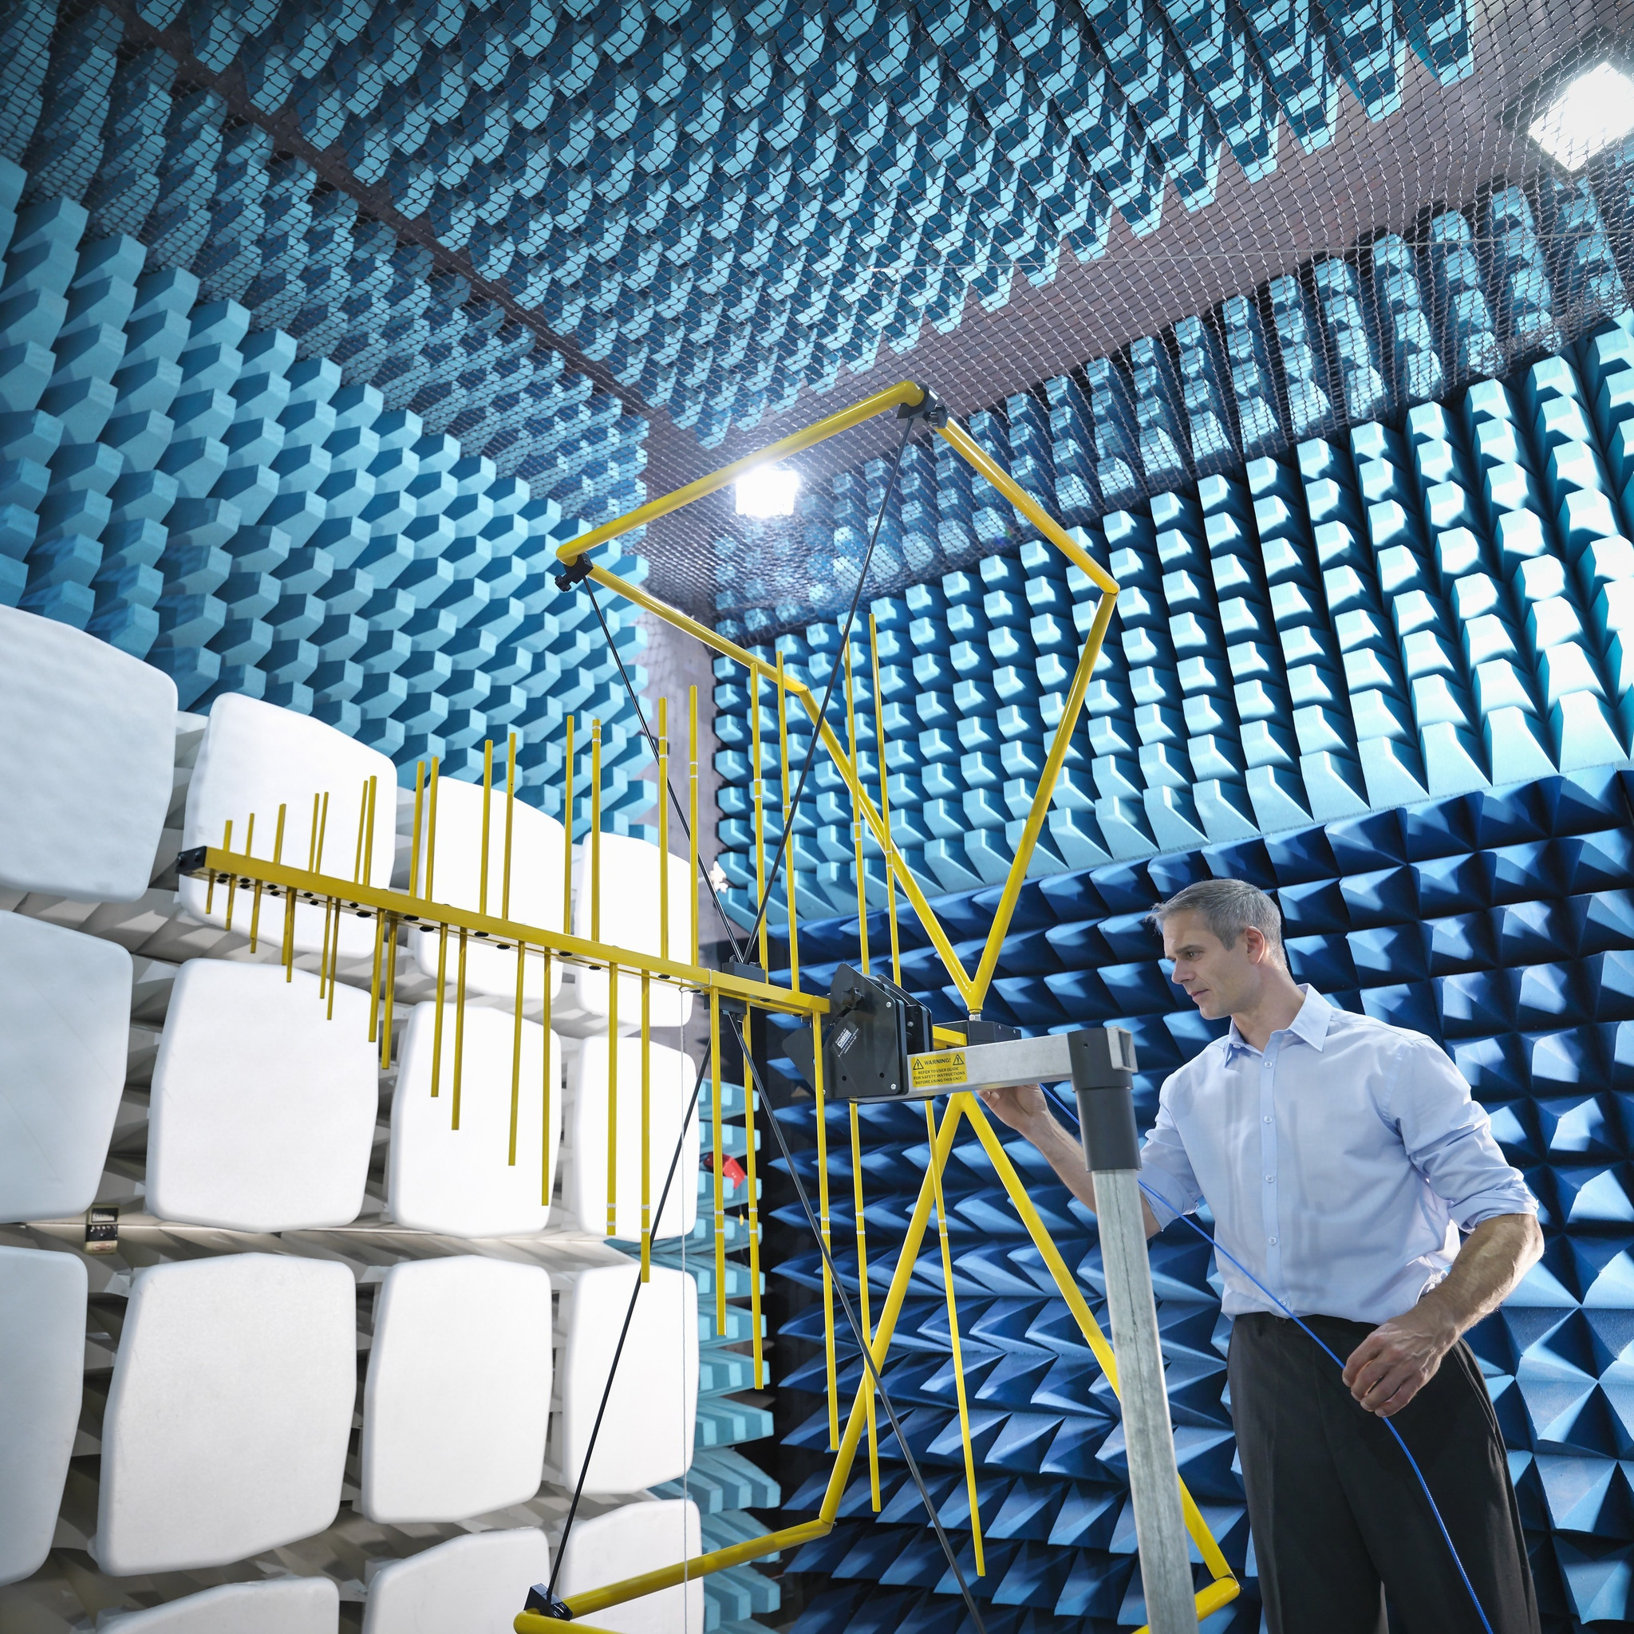
EMC Fundamentals
Notes:
AH

Slide 4
EMC Fundamentals: Technical Terminology
EMC → Electromagnetic compatibility
  Definition: an electronic device’s ability to coexist with other devices without causing functional disturbances & not be disturbed by other devices
EMI → Electromagnetic interference
  Definition: Disruption of an electronic device’s function(s) due to conducted or radiated electromagnetic energy into the device
ESD → Electrostatic discharge
  Definition: Sudden transfer of charge from one object to another

Slide 5
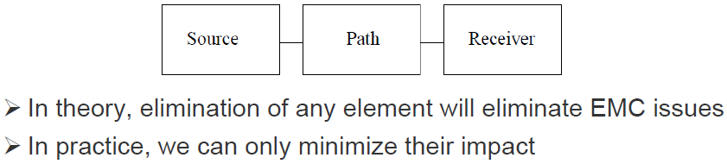
EMC Fundamentals: How is an EMC problem created?
What is EMC:
Ever wonder why you are requested to switch off your electronics devices when you are taking a flight? This is one of the typical case of EMC of which your electronics devices may interfere with the electronics system in the aircraft.
EMC Problem Basics:

Slide 6
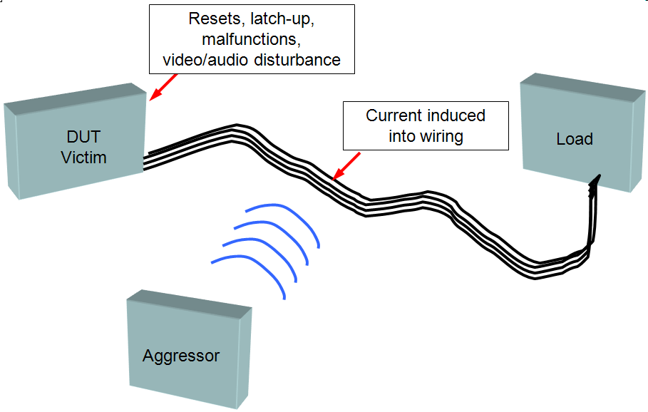
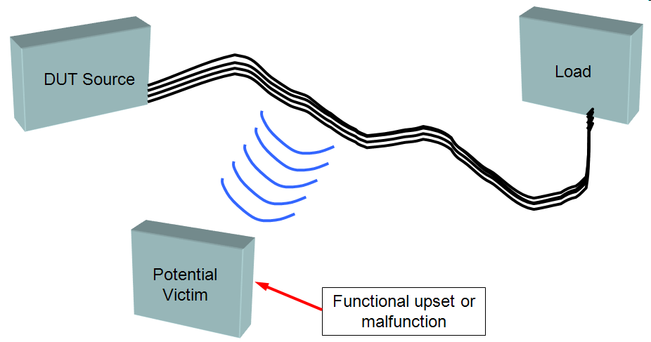
EMC Fundamentals: What makes an EMC problem?
Radiated Emissions
Radiated Immunity

Slide 7
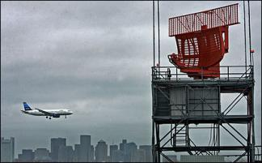

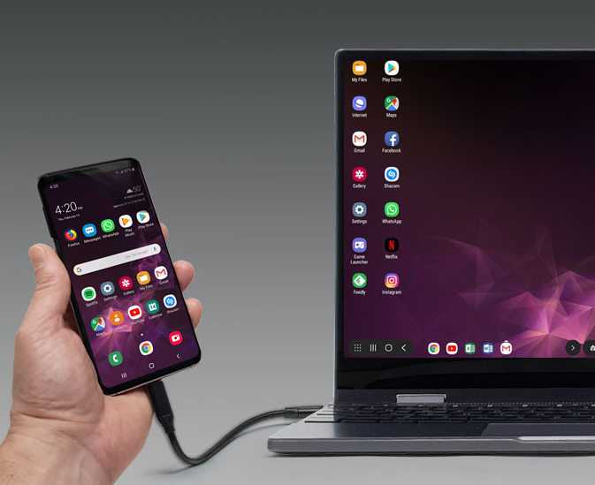
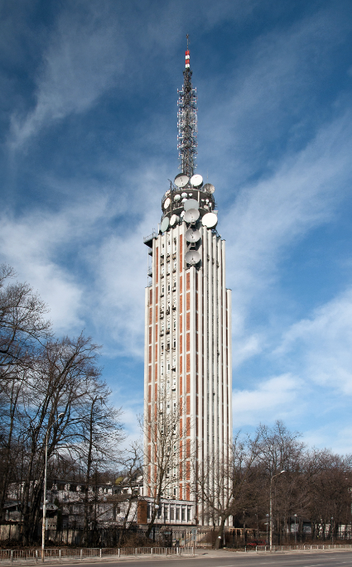
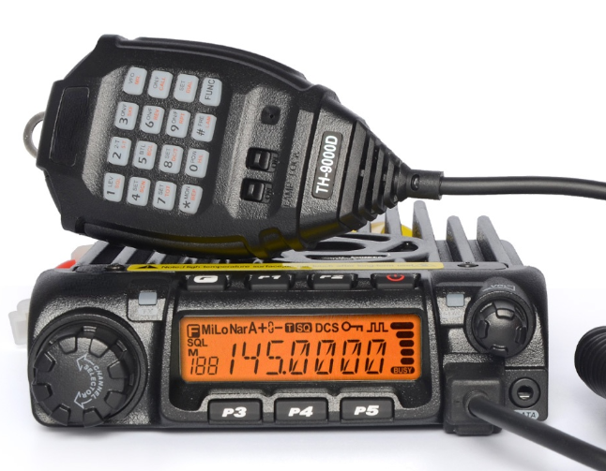
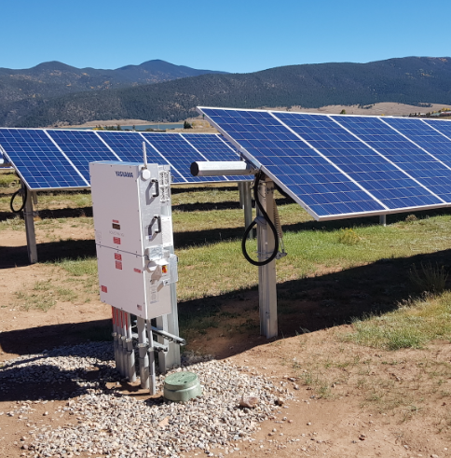

Intentional and Unintentional RF Transmitters

Slide 8

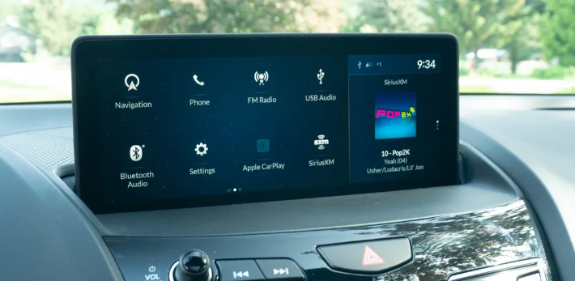
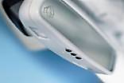




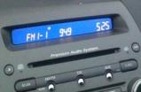



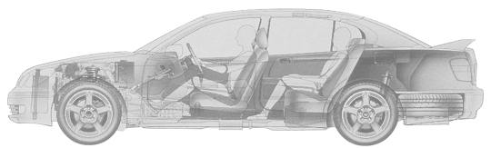





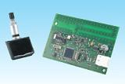





On-Board Electronics
Navigation
Information
Displays
HVAC
Controls
Garage opener
DVD System
ADAS
Compass
Hands free
Clocks
Overhead
Console
Instrument Cluster
Rear view camera
Hybrid Batt.
Management
Contr./Cell
Superv.Contr.
Intelligent
Power Distri-
bution Module
Tire Pressure
Monitoring
System
Access
Control
System
Body and
Interior
Controller
Immobilizer
Park
Distance
Indicator
Rear Seat Entertainment

Slide 9
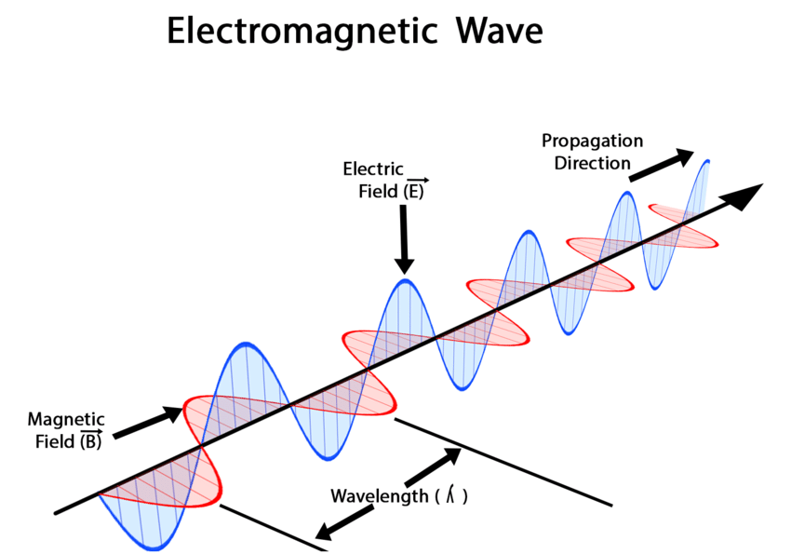
ElectroMagnetic Fields
(EM-Field)
Notes:
AH

Slide 10
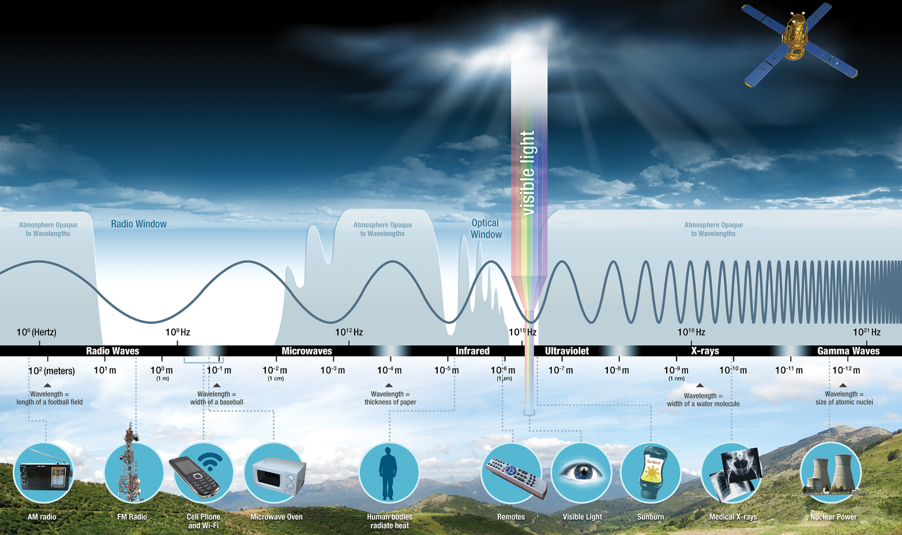
ElectroMagnetic Fields: Overview
Notes:
AH

Slide 11
Electric and magnetic field Sources:
Electric fields are created by differences in voltage: the higher the voltage, the stronger will be the resultant field. Magnetic fields are created when electric current flows: the greater the current, the stronger the magnetic field.
Electric and Magnetic Fields: Overview
Electric Fields
Magnetic Fields
Electric fields arise from voltage (ΔV/Δt)
Their strength is measured in Volts per meter (V/m)
An electric field can be present even when no current is flowing.
Field strength decreases with distance from the source.
Magnetic fields arise from current (ΔI/Δt).
Their strength is measured in Amperes per meter (A/m).
Magnetic fields exist as soon as a device/circuit is switched on and current flows.
Field strength decreases with distance from the source.
Notes:
AH

Slide 12
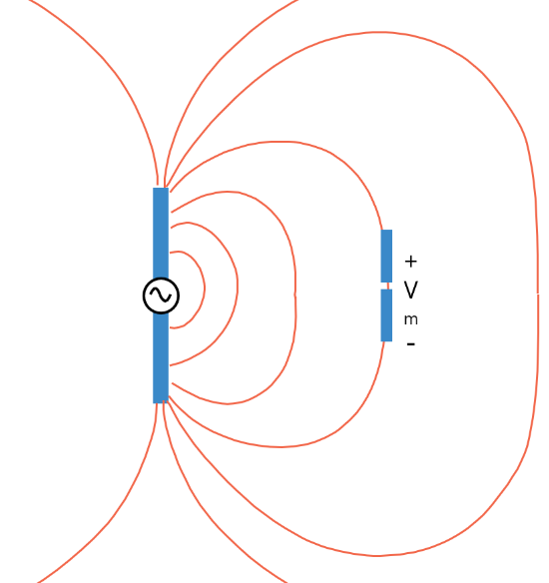
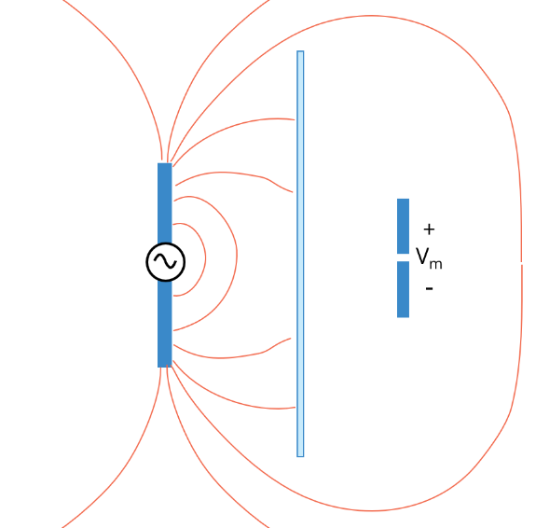
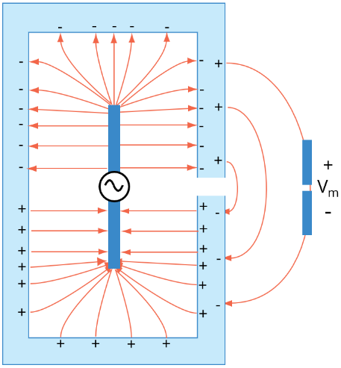
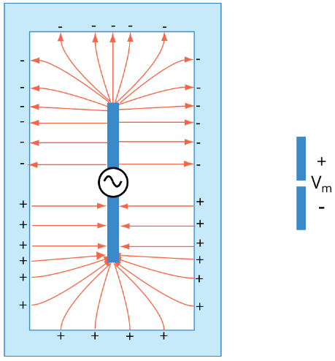
Electric Field: Shielding
Enclosures that are not perfectly conducting are still good Faraday cages as long as the charges can redistribute themselves fast enough to cancel the internal fields. Most metallic enclosures without significant seams or apertures provide excellent electric field shielding over a wide range of frequencies.
NO SHIELD
METAL PLATE
ENCLOSURE WITH AN OPENING
PERFECT ENCLOSURE
Notes:
AH

Slide 13
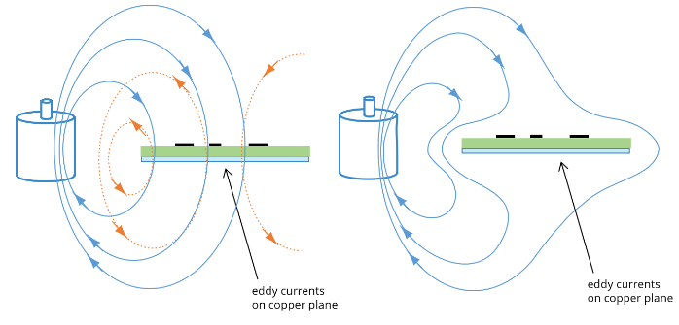
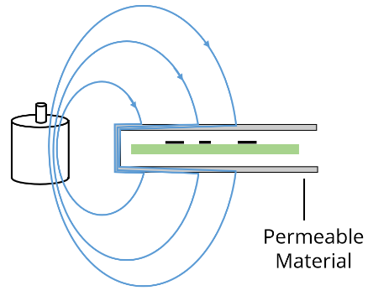
Magnetic Field: Shielding
INCIDENT AND EDDY CURRENT FIELDS (SHOWN SEPARATE)
INCIDENT AND EDDY CURRENT FIELDS COMBINED
DIVERTED FIELD DUE TO PERMEABLE MATERIAL SHIELD
*
*Currents induced in a conducting material by a time-varying magnetic field in this manner are called eddy currents. eddy currents cause the magnetic flux to be diverted around the plate and significantly reduce the coupling to the circuit. Since the eddy currents are driven by time-varying fields, a conductive plate cannot divert a static magnetic field. Even if the field is slowly varying, losses in the conducting plate will cause the eddy currents to dissipate allowing the magnetic flux to penetrate the plate.
For this reason, conductive materials are generally poor magnetic shields at low frequencies (e.g. below a few hundred kHz). Conductive magnetic shields are also ineffective if they have slots or gaps that interrupt the flow of the eddy currents.
Notes:
AH

Slide 14
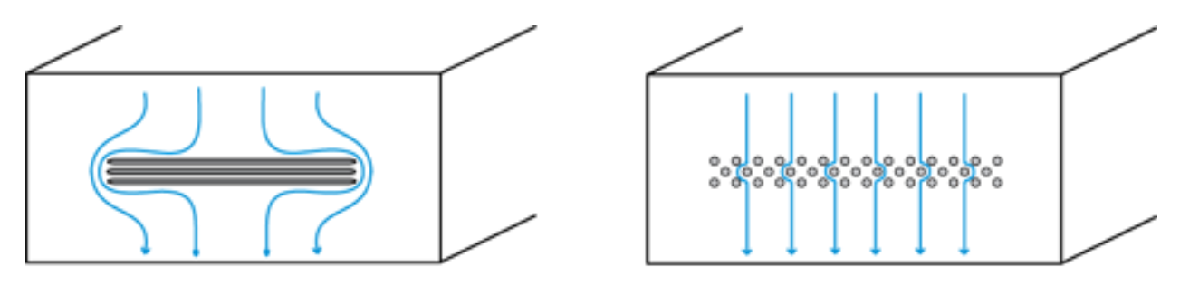
Shielding Enclosures
LARGE SLOTS ON A METAL ENCLOSURE
MULTIPLE SMALL OPENINGS ON A METAL ENCLOSURE
At high frequencies it is possible for the currents induced on the shield to radiate as well as (or possibly much better than) the original source of the fields. This is possible whenever the maximum dimension of the shield is a significant fraction of a wavelength or larger. At these frequencies, it is generally necessary to enclose the source completely while paying close attention to any apertures, seams or cable penetrations that could allow electromagnetic energy to escape.
Notes:
AH

Slide 15
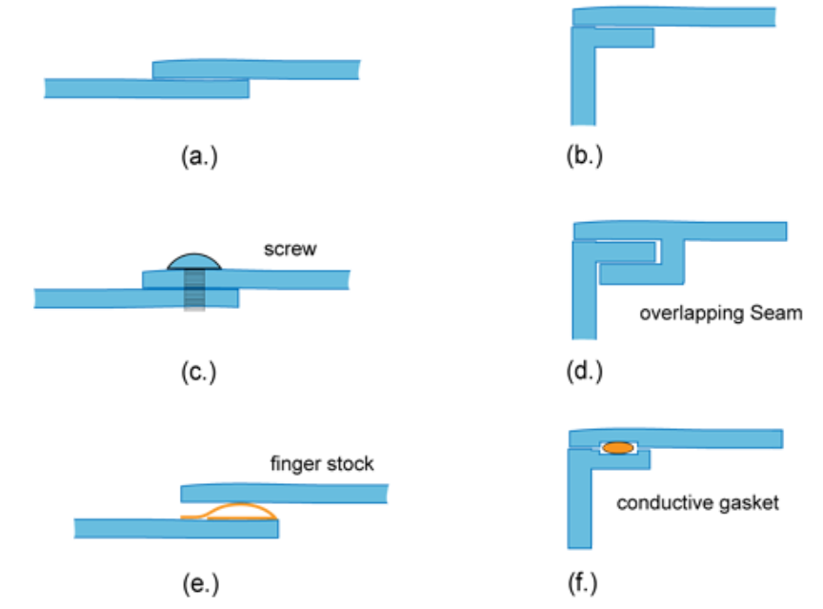
Shielding Enclosures
A seam that optically appears to be well sealed can often disrupt the flow of surface currents significantly causing a major breach in the shielding enclosure.
For example, two metal surfaces simply pressed against each other as illustrated in (a) or (b) rarely provide sufficiently reliable contact at high frequencies. Surface oxidation, corrosion and warping on the metal plates reduce the quality of the electrical contact. Screws or rivets (c) can provide a good electrical contact at points, but they do not necessarily improve the connection at locations between fasteners.
One technique for reducing the impedance of seams is to overlap both sides of the plates as illustrated in (d). Another common solution is to employ finger stock or gaskets as shown in (e) and (f).
Notes:
AH

Slide 16
Why are Digital/Periodic Signals Causing EMI?
Notes:
AH

Slide 17
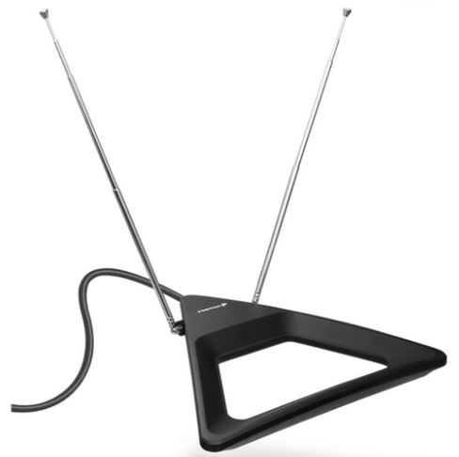
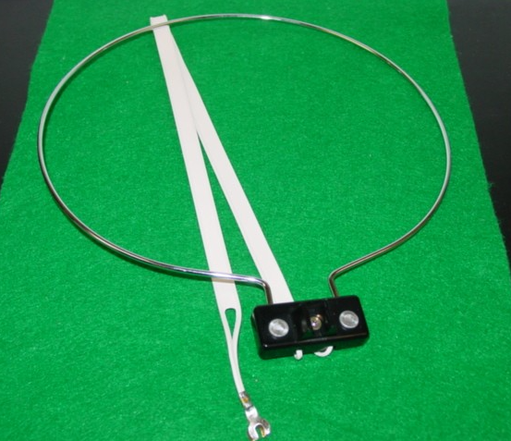
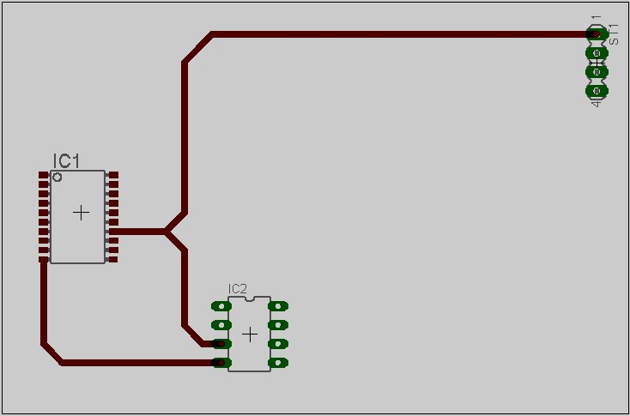
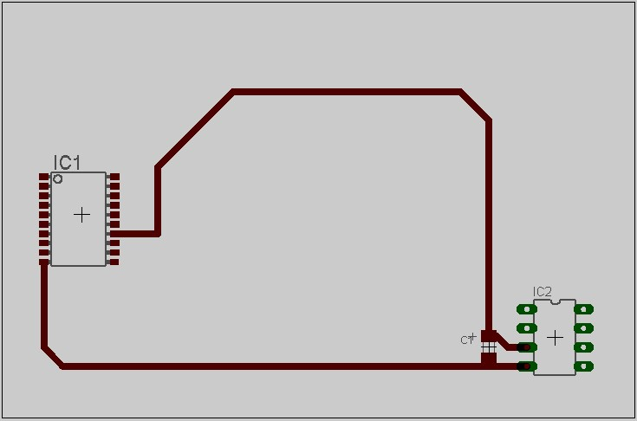
Electric and Magnetic Field Sources on a PCB
ELECTRICAL
MAGNETIC
Dipole antenna
Z high
Loop antenna
Z low
Notes:
AH

Slide 18
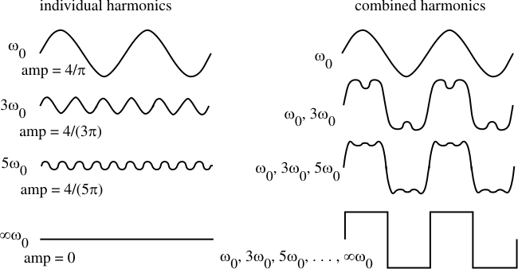
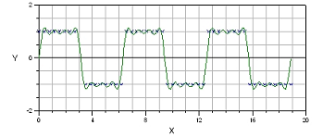
Harmonics of a Periodic (CLK) Signal
-20dB/decade slope
Signal Rise Time Matters!
The faster the rise/fall times are – the more harmonics are required to characterize the signal waveform.
Recommendation is to use the slowest rise/fall times possible (while the device functionality is still OK)
Amplitude
-40dB/decade slope
f
3f
5f
1/(π*trise)
Frequency
Notes:
SF

Slide 19
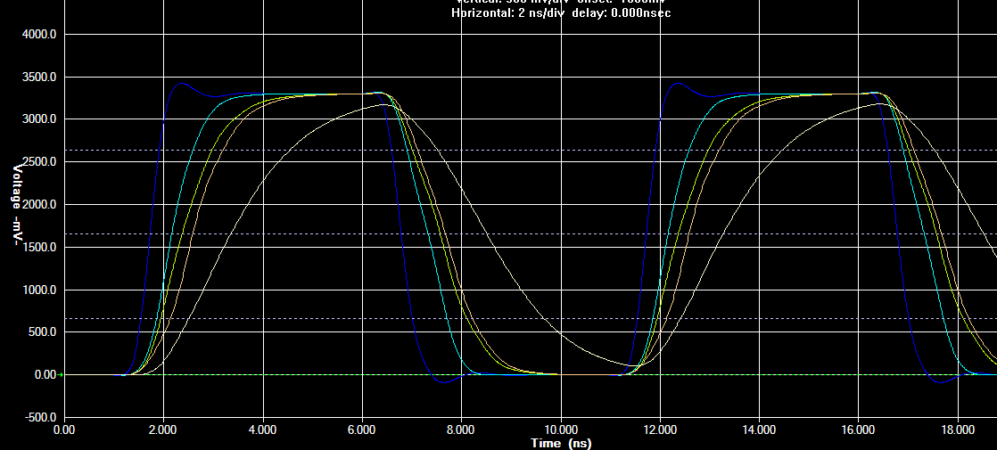
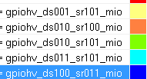
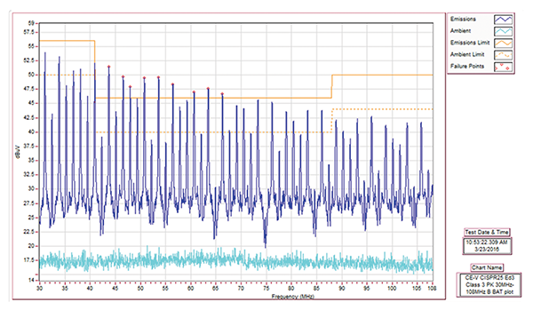
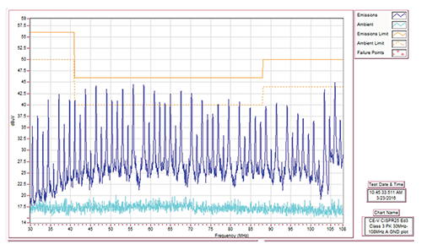
Signal Rise Time: Effects on EMC Emissions
 | tRise, ns | tFall,ns
 | 1.9 | 2.1
 | 1.05 | 1.1
 | 1 | 1.1
 | 0.7 | 0.8
0.4 0.4
Notes:
An electric field will exist even when there is no current flowing. If current does flow, the strength of the magnetic field will vary with power consumption but the electric field strength will be constant.

Slide 20
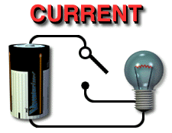

Current Loops
Current ALWAYS flows in a loop. If we break the loop – the current will try to find another. If not possible to do so – it simply stops flowing! And “loops” come in different shapes and sizes!

Slide 21
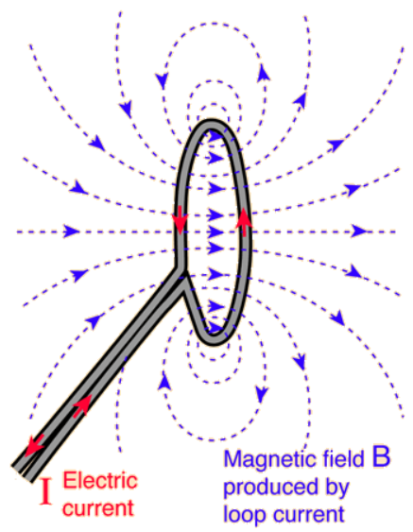
Current Loops
When current flows in a loop – it creates magnetic field around it.
At DC this will be a static magnetic field but at non-zero frequencies this will generate a changing magnetic field which is radiated to the outside world and if this is not intentional (unlike an antenna, where it is intentional), we call this EMI. So in short, loops that carry non-DC currents generate EMI.

Slide 22
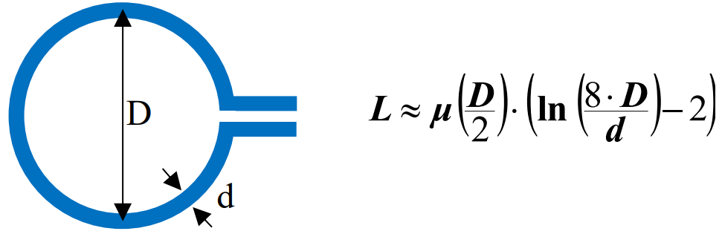
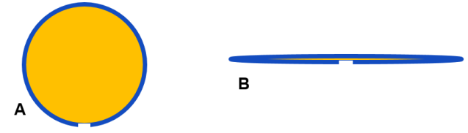
Current Loops
The relation between current and the generated magnetic field is given by the inductance of the loop.
The inductance greatly depends on diameter D of the loop. That means that in the following figure loop B has less inductance than loop A, simply because the area of B is smaller than A. As the impedance of an inductance ZL = ωL, loop B will also have a lower impedance than loop A.
Notes:
For low EMI we want Small Loops = Low Inductance = Low Impedance.

Slide 23
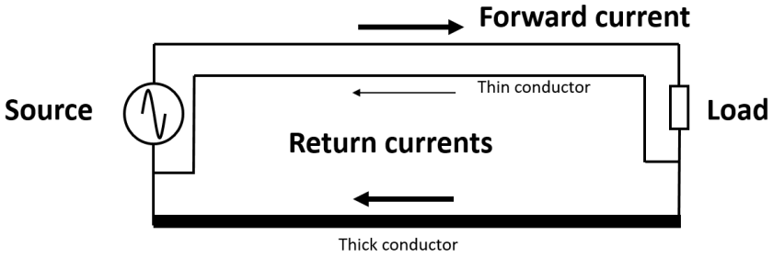
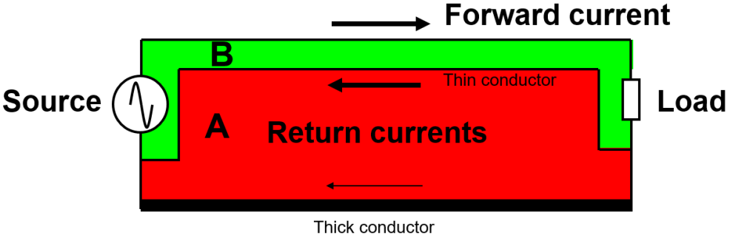
Current Loops
For low EMI we want Small Loops = Low Inductance = Low Impedance.
At DC most of the return current will flow through the thick conductor, However, with increasing frequency of the signal, the impedance of the return path is not only defined by the resistances of the conductors, but also by their inductances because Z=ωL, and because inductance is related to the loop area, a large loop has a large impedance.
Notes:
For low EMI we want Small Loops = Low Inductance = Low Impedance.

Slide 24

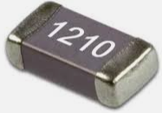
Return Current Path as a Function of Frequency
|ZR| = R |ZL| = ωL |ZC| = $\frac{1}{\text{ω}C}$ , where ω = 2πf
@ DC
@ 100MHz
Source = 1V
Source = 1V
Load = 50 ohm
Load = 50 ohm

Slide 25
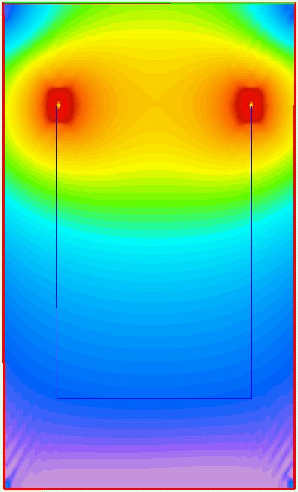
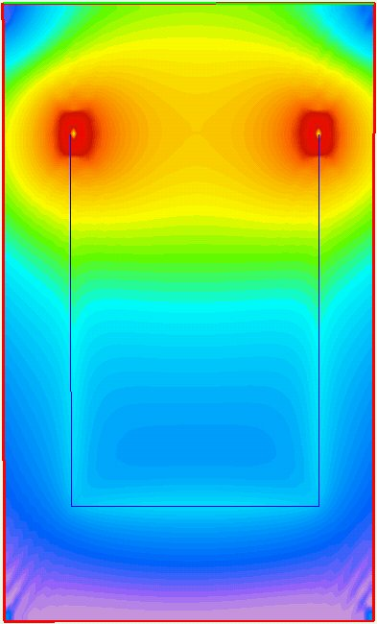
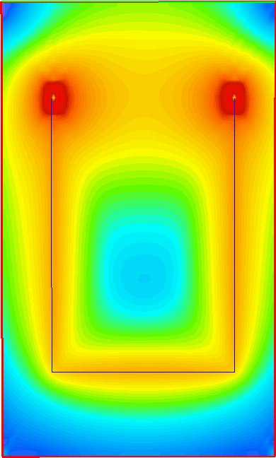
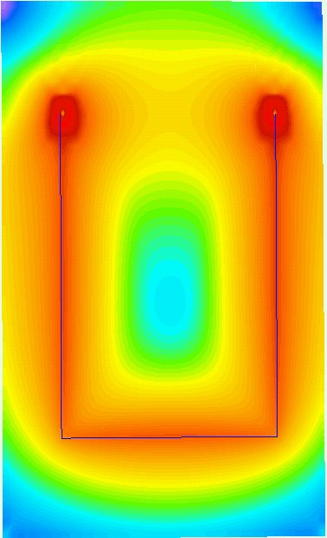
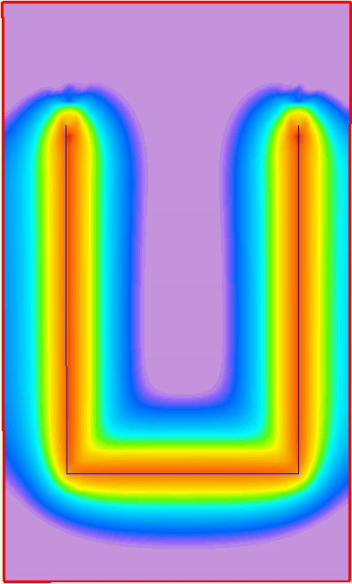
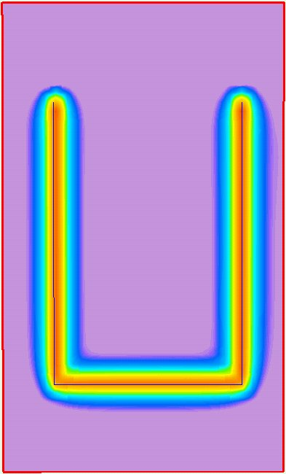
Return Current Path as a Function of Frequency
1kHz
100kHz
500kHz
1MHz
10MHz
100MHz

Slide 26
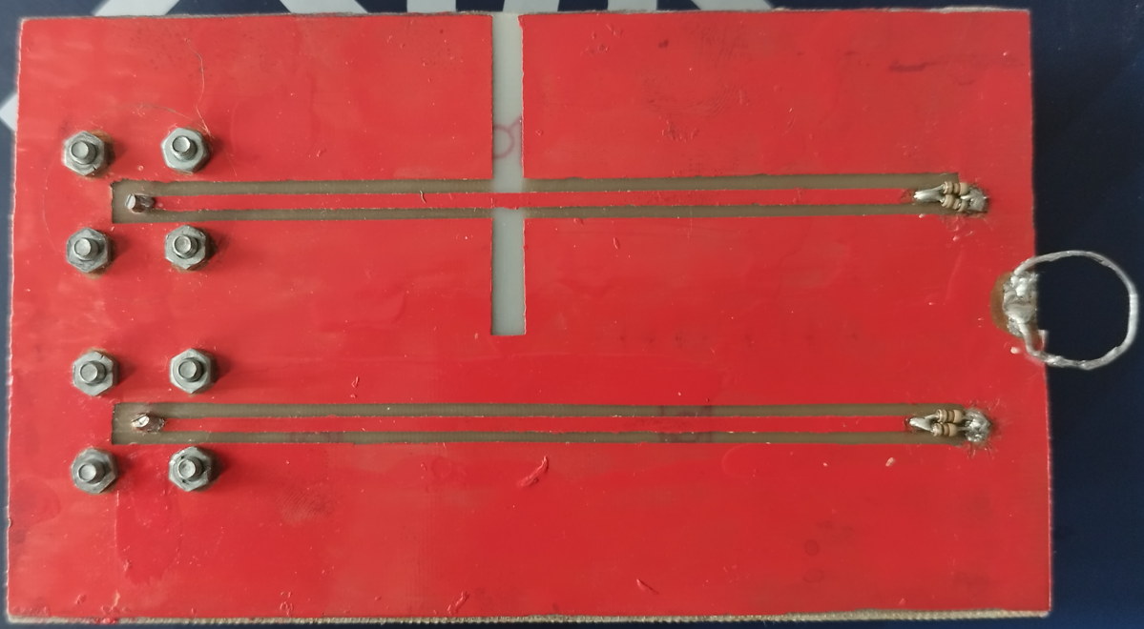
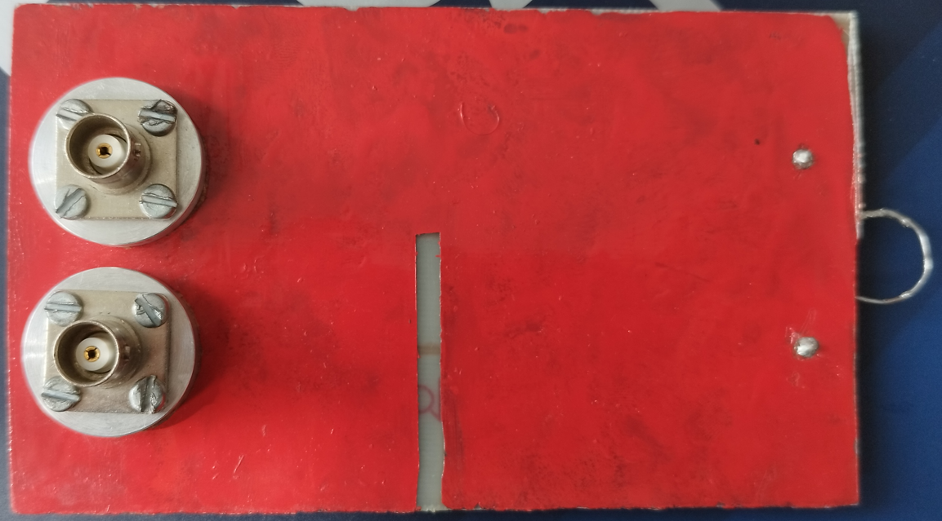
Return Current path: Trace Routed Over Ref. Plane Split
Experiment Time!

Slide 27
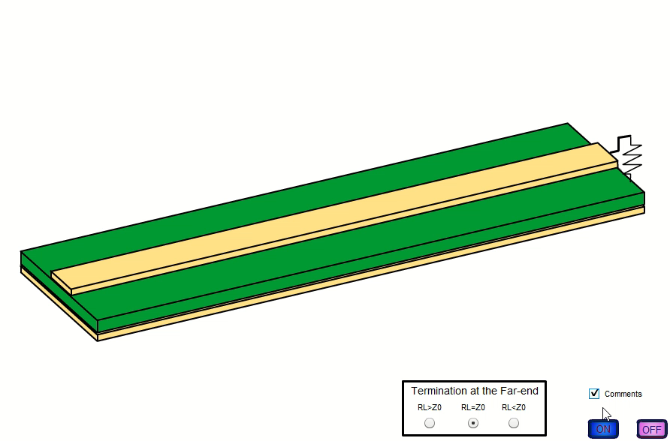
Return Current
1.5ms
Burgas
Sofia
1.5ms

Slide 28


Return Current: Takeaways
ALWAYS control the return current paths
Large current loops areas create Emissions
ALWAYS minimize current loops areas
Notes:
AH

Slide 29

Currents: Common and Differential Mode
  Radiation from digital electronics can occur as either differential mode or common mode.
Notes:
AH

Slide 30
Currents: Differential Mode
Differential Mode emissions are created by the differentially flowing forward and return currents (opposite directions)
Differential Mode current paths are easy to identify, as they are created by the normal operation of the circuit
Differential Mode currents create EM fields that cancel each other
Large differential mode currents are required to create an EMC Emissions issue (Rule of thumb: >10mA)
Notes:
AH

Slide 31
Currents: Common Mode
Common Mode emissions are created by currents flowing in the same direction
Common Mode current paths are usually difficult to identify, as they are not created by the normal operation of the circuit
Common Mode currents create EM fields that do not cancel each other
Very small common mode currents are required to create an EMC Emissions issue (Rule of thumb: >1μA)
Notes:
AH

Slide 32
Currents: Common Mode
Common Mode emissions are created by currents flowing in the same direction
Common Mode current paths are usually difficult to identify, as they are not created by the normal operation of the circuit
Common Mode currents create EM fields that do not cancel each other
Very small common mode currents are required to create an EMC Emissions issue (Rule of thumb: >1μA)
Notes:
AH

Slide 33



Currents: Question
D+
D-
D+
D-
Notes:
AH

Slide 34

EMC Emissions: Differential Mode
  Differential Mode Radiation is the result of the normal operation of the circuit and results from current flowing around loops formed by the conductors of the circuit.
  These loops act as small loop antennas that radiate predominately magnetic fields. Although these signal loops are necessary for circuit operation, their size and area must be controlled during the design process to minimize the radiation.
Notes:
AH

Slide 35

EMC Emissions: Common Mode
Icm1
Icm2
Vcm
  Common Mode Current: Icm1 – Icm2 If there is any unbalance, then Icm1 ≠ Icm2
  Common Mode Radiation is the result of parasitics in the circuit and results from undesired voltage drops in the conductors. The differential mode current that flows through the ground impedance produces a voltage in the digital ground system. Because these parasitic impedances are not intentionally designed into the system or shown in the documentation, common-mode radiation is often harder to understand and control.
Notes:
AH

Slide 36


EMC Emissions
Measured in dBuV (Voltage Method)
Notes:
AH

Slide 37
EMC Emissions: Under Control
DIFFERENTIAL Mode Emissions
COMMON Mode Emissions
  Board layout by reducing the loop area. Clock signals should be routed first on a PCB. The length of the clock trace should be minimized, as well as the number of vias used. On a multilayer PCB, clocks should be routed on a layer adjacent to a solid (not split) ground plane.
  Reduce the magnitude of the current.
  Slow down signal rise and fall times using software as the first option or by adding a series resistor.
  Minimize crosstalk - clock traces should not be run parallel to data bus or signal leads for long distance.
  Use Spread Spectrum whenever possible with maximum modulation span without violating specifications or distorting the signal.
  Minimize GND Impedance (use dedicated GND planes, avoid creating slots on those and stich with GND vias all other GND structures to it). Use as many dedicated GND layers as Program Budget allows.
  Pay special attention to GND islands around/below connectors. It has to be solid and uninterrupted while connector GND pins must have a good (low impedance) connection to it.
  Slow down signal rise and fall times
  Use very tight intra-pair (P to N) differential pair length matching. 0.1mm tolerance is a common value.
  Avoid using vias on high-speed traces.
  Minimize Characteristic Impedance mismatch along traces.
Notes:
AH

Slide 38


Standard Types of Automotive EMC Tests
Notes:
AH

Slide 39
EMC Compliance Tests
Emissions
Radiated Emissions
Conducted Emissions
Immunity
Radiated Immunity
Conducted Immunity
ESD
Handling
Powered
Field Coupled
V C
Transients
Electronic Sub-Assembly
EMC
OEM Vehicle-Level EMC

Slide 40


Radiated Emissions: Vehicle-Level EMC Validation
Notes:
AH

Slide 41




Radiated Emissions: Component-Level EMC Validation
Rod Antenna 150kHz – 30MHz
Biconical Antenna 20MHz-300MHz
LogPeriodic Antenna 200MHz-1000MHz
Horn Antenna > 1 GHz
Notes:
AH

Slide 42



Conducted Emissions: Component-Level EMC Validation
Test Setup: Voltage Method (150kHz – 108MHz)
Standard Setup: Voltage Method
VBAT (+) LISN
GND (-) LISN
50Ω
GND Cable
LISN: Line Impedance Stabilization Network
VBAT Cable
DUT
Coax to EMI Receiver
Notes:
AH

Slide 43


ESD Testing
Notes:
As you would imagine, catastrophic failure is the easiest of the three to detect. This type of ESD damage causes some sort of permanent damage such as an oxide failure or a metal melt. The damage done is irreversible. Any device with catastrophic damage is usually found during the testing process and can be dealt with before shipping out.
Latent defects are a little more difficult to spot. This type of damage would allow a device to work properly for the most part, but over time the small amount of damage might affect the life of the device or its ability to function. The issue with latent defects is that the item usually passes testing and is sent to the customer where it may fail.
Lastly, an upset failure is when ESD damages a device or component but not enough to cause complete failure. But while in use, the component may intermittently result in gate failure and cause problems with software and data storage. Just like latent defects, upset failures will pass testing but may have issues in the future.

Slide 44




ESD Fundamentals: Effects of ESD on Electronic Equipment
ESD damage is not created equal. In fact, there are three different types of ESD damage:
  A catastrophic failure
  Latent defect
  An upset failure
Notes:
As you would imagine, catastrophic failure is the easiest of the three to detect. This type of ESD damage causes some sort of permanent damage such as an oxide failure or a metal melt. The damage done is irreversible. Any device with catastrophic damage is usually found during the testing process and can be dealt with before shipping out.
Latent defects are a little more difficult to spot. This type of damage would allow a device to work properly for the most part, but over time the small amount of damage might affect the life of the device or its ability to function. The issue with latent defects is that the item usually passes testing and is sent to the customer where it may fail.
Lastly, an upset failure is when ESD damages a device or component but not enough to cause complete failure. But while in use, the component may intermittently result in gate failure and cause problems with software and data storage. Just like latent defects, upset failures will pass testing but may have issues in the future.

Slide 45



Pre-Compliance Tests: Near-Field EMC Scan
Pre-compliance tests are non-standard ones, performed during prototype development.

Slide 46



EMC SIMULATIONS
Notes:
AH

Slide 47


Signal Integrity Analysis
Driver
Receiver1
Receiver2
Receiver3
Receiver4

Slide 48

DC Drop Analysis

Slide 49



Shielding Effectiveness
Shielding Effectiveness Comparison (similar to a 1m Antenna Measurement)
Design Modifications are being analyzed in order to reduce time spent in EMC Lab.

Slide 50

Shielding Effectiveness
Surface Currents’ flow paths at 2.4GHz. “Hot spots” are identified and countermeasures are to be applied in these areas.

Slide 51


Cavity Resonance
E-Fields inside the box at a cavity resonance frequency (1.4GHz)
Original Design (No Additional GND contact)
Modified Design (One Additional GND contact)

Slide 52

Cavity Resonance
Cavity Resonance study of cluster – E field @ 368MHz

Slide 53



ESD Simulation
Model of the ESD Gun
Simulation model of the device

Slide 54


