Slide 1
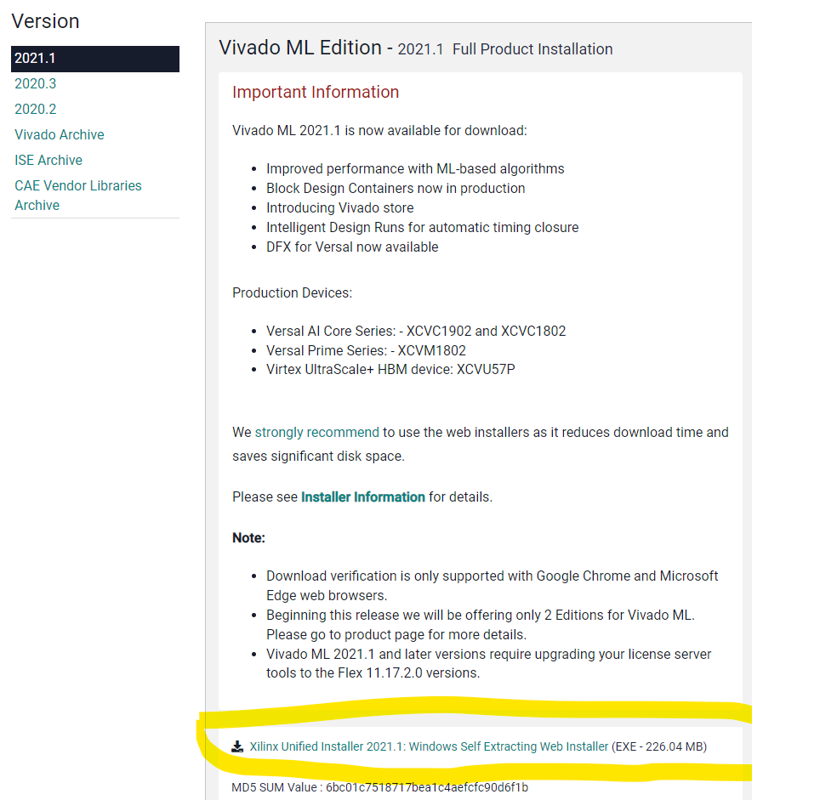
https://www.xilinx.com/support/download.html

Slide 2
