Slide 1
7-Series Architecture Overview

Slide 2
Outline
Introduction to 7-Series FPGA
Logic Resources
I/O Resources
Memory and DSP48 Resources
XADC
Clocking Resources
Zynq SoC

Slide 3
Introduction
All Xilinx FPGAs contain the same basic resources
Logic Resources
Slices (grouped into configurable logic blocks (CLB))
Containing combinatorial logic and register resources
Memory
Multipliers
Interconnect Resources
Programmable interconnect
IOBs
Interfaces between the FPGA and the outside world
Other resources
Global clock buffers
Boundary scan logic
Through various generations, Xilinx added new architectural resources to target various markets and application areas

Slide 4
7-Series FPGA+SoC Families
Maximum Capability
Lowest Power
and Cost
Industry’s Best Price/Performance
Industry’s Highest
Performance
All Programmable SoC
Logic Cells in K | 33 – 215 | 66 – 478 | 583 – 1,139 | 28 – 444
Block RAM in Mb | 2 – 12 | 4 – 34 | 28 – 68 | 2 - 27
DSP Slices | 90 – 740 | 240 – 1,920 | 1,260 – 3,360 | 80–2,020
Peak DSP Perf. (GMACs) | 929 | 2,845 | 5,335 | 2,622
Transceivers | Up to 16 | Up to 32 | Up to 88 | Up to 16
Transceiver Perf. (Gbps) | 6.6 | 12.5 | 12.5, 13.1 and 28 | 6.6, 12.5
Memory Perf. (Mbps) | 1066 | 1866 | 1866 | 1333
User I/O Pins | 106 – 500 | 285 – 500 | 350 – 1,100 | 54 – 400
I/O Voltages | 3.3V and below | 3.3V and below 1.8V and below | 3.3V and below 1.8V and below | 3.3V and below 1.8V and below
Notes:
The Xilinx 7-series FPGAs are a unified set of FPGA families. These families share the same underlying technology, construction, and implementation tools. The families are optimized for different price/performance points to meet all market needs. However, the unified architecture allows unprecedented migration capability from one family to another.
The Zynq®-7000 All Programmable SoC family series architecture contains an ARM®-based processing system that is tightly integrated to the programmable logic. The programmable logic portion of Zynq-7000 devices leverages the Xilinx 7-series programmable logic. This allows designers currently developing on the Xilinx 7-series to seamlessly port their FPGA designs to Zynq-7000 devices.

Slide 5
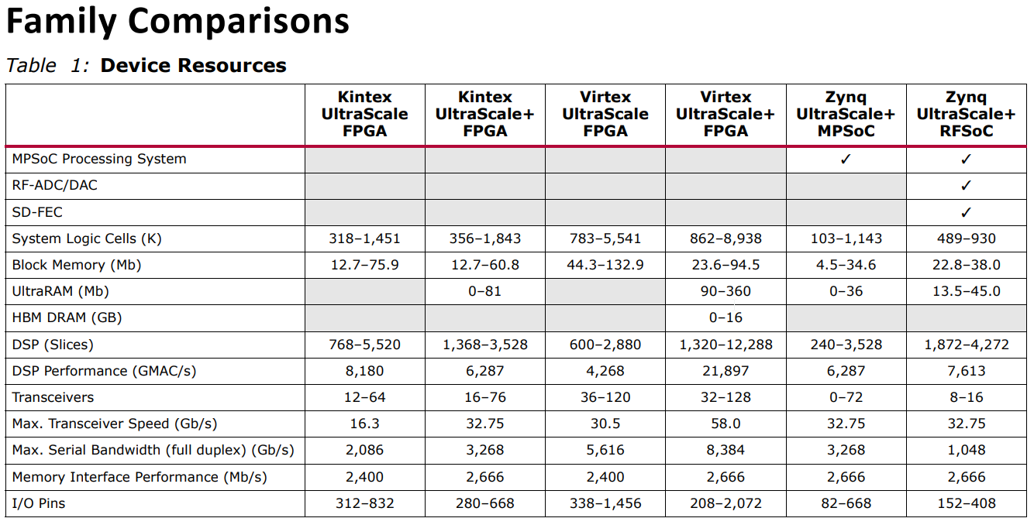

Slide 6
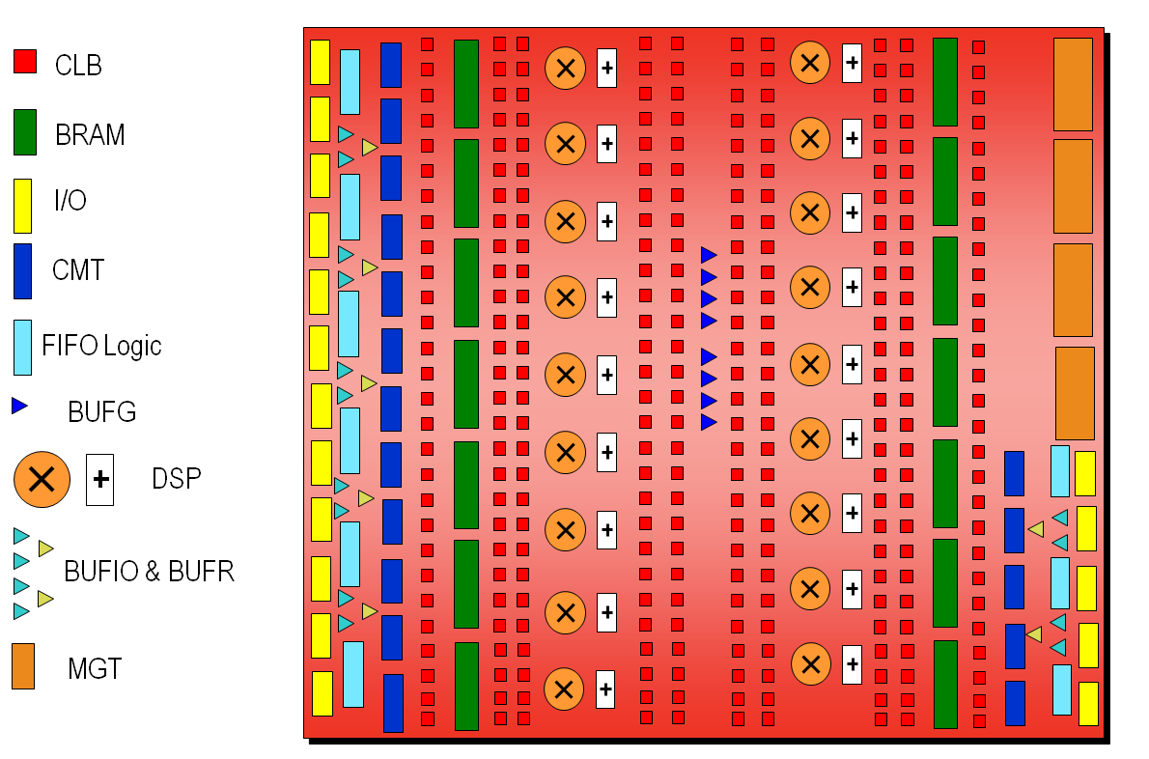
7-Series Architecture Alignment
Common elements enable easy IP reuse for quick design portability across all 7-series families
Design scalability from low-cost to high-performance
Expanded eco-system support
Quickest time to market
Artix-7 Architecture Overview
Notes:
All 7-series families share the same basic building blocks. The mixture and number of these resources varies across families.

Slide 7
Outline
Introduction to 7-Series FPGA
Logic Resources
I/O Resources
Memory and DSP48 Resources
XADC
Clocking Resources
Zynq SoC

Slide 8
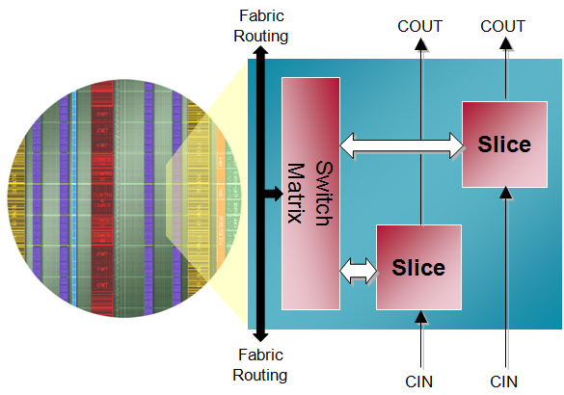
Configurable Logic Block (CLB) in 7-Series FPGAs
Primary resource for design in Xilinx FPGAs
Combinatorial functions
Flip-flops
CLB contains two slices
Connected to switch matrix for routing to other FPGA resources
Carry chain runs vertically in a column from one slice to the one above

Slide 9
Slice Resource
Four six-input Look-Up Tables (LUT)
Multiplexers
Carry chains
SRL
Cascade path is not shown
Four flip-flops/latches
Four additional flip-flops
The implementation tool will pack multiple slices in the same CLB if certain rules are followed

Slide 10
6-Input LUT with Dual Output
LUTs can be two 5-input LUTs with common input
Minimal speed impact to a 6-input LUT
One or two outputs
Any combinatorial function of six variables or two functions of five variables
Notes:
LUTs can perform any combinatorial function limited only by the number of inputs. It is your primary combinatorial logic resource and it is the industry standard.
The look-up table functionality is essentially a small memory containing the desired output value for each combination of input values.
The truth table for the desired function is stored in the memory.
The inputs of the function act as the address to be read from the memory (essentially a multiplexer controlled by the inputs).
The values for the storage elements are generated by the software tools, and downloaded to all LUTs at configuration time.
Each 6-input LUT can be configured as two 5-input LUTs. This gives the device a great deal of flexibility to build an efficient design.
Thus, the LUT can be used to build any function of six variables or two independent functions of the same five variables.
The synthesis and implementation tools use these resources to build combinatorial functions automatically.

Slide 11
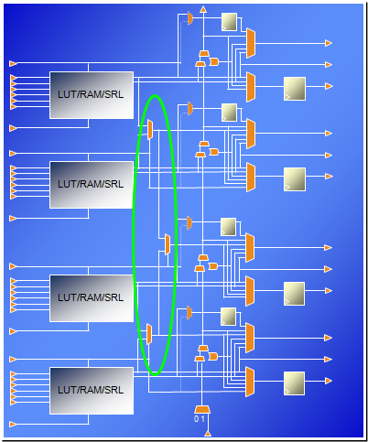
Wide Multiplexers
Each F7MUX combines the outputs of two LUTs together
Can implement an arbitrary 7-input function
Can implement an 8-1 multiplexer
The F8MUX combines the outputs of the two F7MUXes
Can implement an arbitrary 8-input function
Can implement a 16-1 multiplexer
MUX is controlled by the BX/CX/DX slice input
MUX output can drive out combinatorially or to the flip-flop/latch

Slide 12
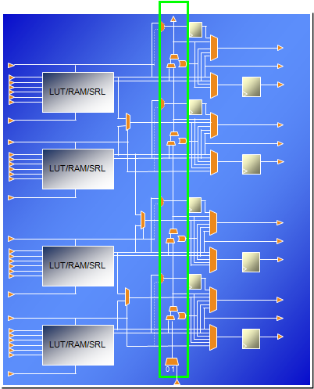
Carry Chain
Carry chain can implement fast arithmetic addition and subtraction
Carry out is propagated vertically through the four LUTs in a slice
The carry chain propagates from one slice to the slice in the same column in the CLB above
Carry look-ahead
Combinatorial carry look-ahead over the four LUTs in a slice
Implements faster carry cascading from slice to slice

Slide 13
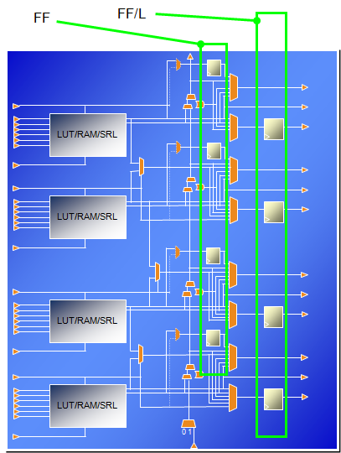
Slice Flip-Flops and Flip-Flop/Latches
Each slice has four flip-flop/latches (FF/L)
Can be configured as either flip-flops or latches
The D input can come from the O6 LUT output, the carry chain, the wide multiplexer, or the AX/BX/CX/DX slice input
Each slice also has four flip-flops (FF)
D input can come from O5 output or the AX/BX/CX/DX input
These don’t have access to the carry chain, wide multiplexers, or the slice inputs
If any of the FF/L are configured as latches, the four FFs are not available
Notes:
The four primary storage elements are referred to as “flip-flop/latch” elements. These correspond to the storage elements that existed in previous generations. They are named AFF/LATCH, BFF/LATCH, CFF/LATCH, and DFF/LATCH.
The four secondary storage elements are referred to simply as “flip-flop” elements. They are named AFF, BFF, CFF, and DFF.

Slide 14
SLICEM Used as a Distributed SelectRAM Memory
SLICEM can be used for memory
Synchronous write, asynchronous read
Can be converted to synchronous read using the flip-flops available in the slice
Various configurations
Single port
One LUT6 = 64x1 or 32x2 RAM
Cascadable up to 256x1 RAM
Dual port (D)
1 read / write port + 1 read-only port
Simple dual port (SDP)
1 write-only port + 1 read-only port
Quad-port (Q)
1 read / write port + 3 read-only ports
Notes:
The look-up table functionality is essentially a small memory containing the desired output value for each combination of input values. These storage cells are programmed at configuration time, and the look-up itself is done by using the inputs as the control for a wide multiplexer.
By allowing these storage elements to be modified using FPGA fabric resources, the LUT can be used for the implementation of a small distributed memory.
Each LUT can be a single ported 64-bit RAM with synchronous write and asynchronous read. LUTs in slices can be combined to create small dual-port and multi-port RAMs.
Approximately one quarter of the slices in each 7-series device is a SLICEM, which has LUTs that can be used as distributed SelectRAMâ„¢ memory.

Slide 15
SLICEM Used as 32-bit Shift Register
SRL = Shift Register Lut
Versatile SRL-type shift registers
Variable-length shift register
Synchronous FIFOs
Content-Addressable Memory (CAM)
Pattern generator
Compensate for delay / latency
Shift register length is determined by the address
Constant value giving fixed delay line
Dynamic addressing for elastic buffer
Cascadable up to 128x1 shift register in one slice
Notes:
In the SLICEM slices, the LUT can also be configured as a dynamically addressable shift register. This component basically acts as a programmable pipeline delay element.
There are no set or reset capabilities, it is not loadable, and data can only be read serially. To ensure that software can map pipeline delays to the SRL, be sure to code them with these restrictions in mind.
Each LUT6 can implement a maximum delay of 32 clock cycles. The SRLs within a slice can be cascaded for longer shift registers (up to 128).
The shift register length can be changed asynchronously by changing the value applied to the address pins (A). This means that you can dynamically change the pipeline delay associated with an SRL.

Slide 16
Outline
Introduction to 7-Series FPGA
Logic Resources
I/O Resources
Memory and DSP48 Resources
XADC
Clocking Resources
Zynq SoC

Slide 17
I/O Interface Challenges
High-speed operation with maintained signal integrity
Source-synchronous operation (clock forwarding)
System-synchronous operation (common systems clock)
Terminate transmission lines to avoid signal reflections
Drive and receive data on wide parallel buses
Compensate for bus skew and clock timing errors
Conversion between serial and parallel data
Achieve very high bit rate (> 1 Gbps)
Single Data Rate (SDR) or Double Data Rate (DDR) interfaces
Interface to many different standards
Different voltages, drive strengths and protocols

Slide 18
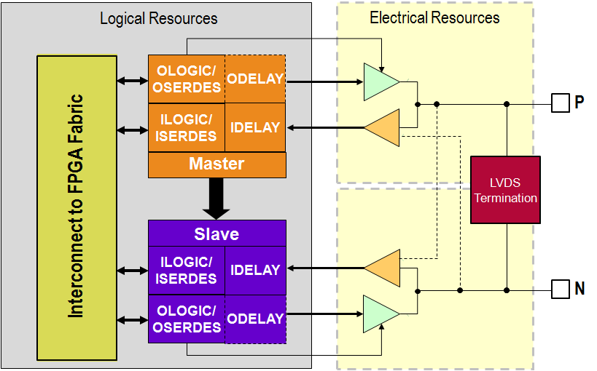
7-Series FPGA I/O
Wide range of voltages
1.2V to 3.3V operation
Wide I/O standards support
Single ended and differential
Referenced voltage inputs
3-state capability
Very high performance
Up to 1600 Mbps LVDS
Up to 1866 Mbps single-ended for DDR3
Easy memory interfacing
Hardware support for QDRII+ and DDR3
Digitally controlled impedance
Power reduction features

Slide 19
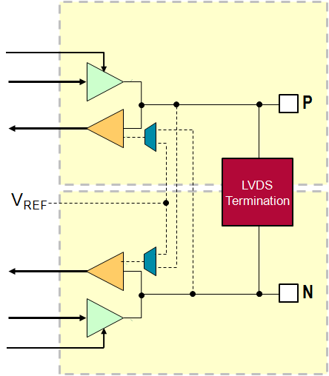
I/O Electrical Resources
P and N pins can be configured as
Individual single-ended signals or
Differential pair
Receiver can be standard CMOS or voltage comparator
When standard CMOS
Logic 0 when "near" ground
Logic 1 when "near" V_{CCO}
Referenced to V_{REF}
Logic 0 when below V_{REF}
Logic 1 when above V_{REF}
Differential
Logic 0 when V_{P} < V_{N}
Logic 1 when V_{P} > V_{N}
Notes:
The V_{REF} used for referenced protocols can either be provided from a pin or from an internally generated voltage.
If sourced externally, pins in the bank are used to provide the reference voltage.
The internally generated V_{REF} is derived from V_{CCAUX}, and must be set to the proper value using an attribute.
When the internally generated V_{REF} is used, the V_{REF} pins are available for user I/O.
There is a performance advantage to using an externally sourced V_{REF}

Slide 20
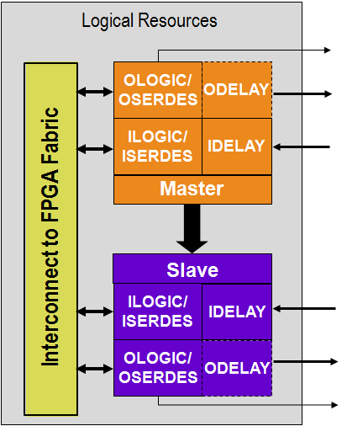
I/O Logical Resources
Two blocks of logic per I/O pair
Master and slave
Can operate independently or concatenated
Each block contains
ILOGIC/ISERDES
SDR, DDR, or high-speed serial input logic
OLOGIC/OSERDES
SDR, DDR, or high-speed serial output logic
IDELAY
Selectable fine-grained input delay
ODELAY
Selectable fine-grained output delay
Only available on High Performance I/O

Slide 21
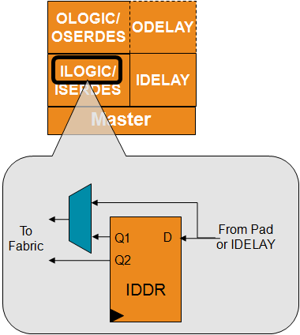
ILOGIC: Input SDR and DDR Logic
Two types of ILOGIC blocks
ILOGICE2 for High Performance banks
ILOGICE3 for High Range banks
Has zero hold delay capability
ILOGIC inputs come from the input receiver
Directly or via the IDELAY block
Outputs drive the FPGA fabric
Directly (no clocked logic) or
Via the IDDR
In SDR mode on rising or falling edge of clock
In DDR mode on both edges of clock
Can also use two clocks, 180° out of phase
Notes:
The ILOGICE3 (in High Range banks) supports the zero hold (ZHOLD) capability. When an IOB flip-flop is clocked directly from an input clock via a global buffer (with no MMCM or PLL for deskew), the tools will add the ZHOLD delay. This delay is internally balanced with the clock insertion delay to ensure that there is a zero or negative hold time requirement for the IOB flip-flop.

Slide 22
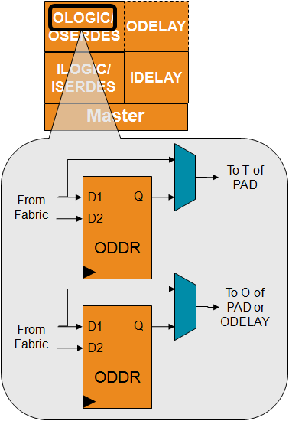
OLOGIC: Output SDR and DDR Logic
OLOGICE2 for HP banks, OLOGICE3 for HR banks
Output of OLOGIC connects to the output driver directly, or via the ODELAY
ODELAY is available in HP banks only
Output is driven directly from the fabric
Directly, through an SDR flip-flop or via the ODDR using both edges of clock
Each OLOGIC block contains two ODDR
One for controlling the data to the output driver
One for controlling the 3-state enable
Both ODDR are driven by same clock and reset
SAME_EDGE or OPPOSITE_EDGE only

Slide 23
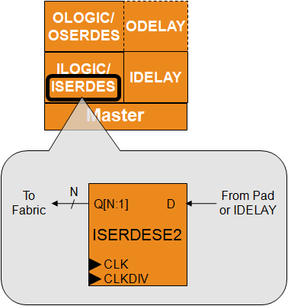
ISERDES: Input Serial-to-Parallel Converter
Clocks in data from input pad or IDELAY
D is clocked on high speed clock (CLK)
Can be SDR or DDR
Sends de-serialized data to fabric
Q is clocked on low speed clock (CLKDIV)
CLK and CLKDIV must be in phase
De-serializes data
Single data rate: 2, 3, 4, 5, 6, 7, 8
Double data rate: 4, 6, 8
Cascade with slave for wider ratios
Double data rate: 10, 14
Has BITSLIP logic for framing parallel data
Notes:
When used in NETWORK mode, the ISERDESE2 provides a powerful mechanism to interface to high-speed, clock-forwarded interfaces.
The ISERDESE2 also supports modes of MEMORY, MEMORY_QDR, and MEMORY_DDR3. In these modes, different clocking options, including support for direct clocking by the data strobe from the memories, is supported. These modes should only be used through the Memory Interface Generator (MIG) interface.
The final mode, OVERSAMPLE, allows the data to be sampled on four phases of the low speed clock, each separated by 90°; no high-speed clock is necessary.
The top-most and bottom-most IOB in each bank do not have an associated slave IOB. Therefore, these pins only support de-serialization rates up to 1:8.
ISERDES has a bitslip mechanism which allows the application to control the framing of the received data.

Slide 24
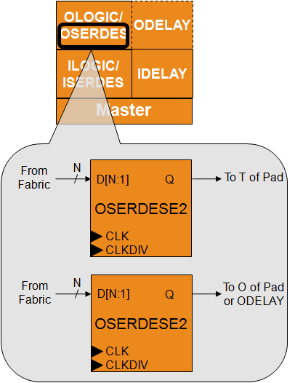
OSERDES: Output Parallel-to-Serial Converter
Serializes out data to output pad or ODELAY
Q is clocked on high speed clock (CLK)
Can be SDR or DDR
Parallel data comes from fabric
D is synchronous to low speed clock (CLKDIV)
CLK and CLKDIV must be in phase
Serializes data
Single data rate: 2, 3, 4, 5, 6, 7, 8
Double data rate: 4, 6, 8
Cascade with slave for wider ratios
Double data rate: 10, 14
When using 3-state serializer, both the data and 3-state width must be 4
Clocks are shared between both serializers
Notes:
The OSERDES is conceptually the opposite of the ISERDES. It accepts up to 8 bits of data on one OSERDES, or 14 bits when the master and slave are cascaded, and serializes them out on a high speed clock (SDR or DDR).
There are two output serializers, one for data and one for the 3-state control. They share the same set of clocks (CLK and CLKDIV); hence, they must have the same serialization. The 3-state serializer can only do 4:1 serialization, so it can only be used when the data serializer is also doing 4:1 serialization.
The top-most and bottom-most IOB in each bank do not have an associated slave IOB. Therefore, these pins only support serialization rates up to 8:1.

Slide 25
Outline
Introduction to 7-Series FPGA
Logic Resources
I/O Resources
Memory and DSP48 Resources
XADC
Clocking Resources
Zynq SoC

Slide 26
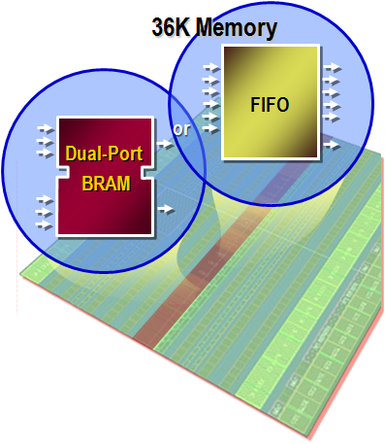
7-Series Block RAM and FIFO
All members of the 7-series families have the same Block RAM/FIFO
Fully synchronous operation
All operations are synchronous; all outputs are latched
Optional internal pipeline register for higher frequency operation
Two independent ports access common data
Individual address, clock, write enable, clock enable
Independent data widths for each port

Slide 27
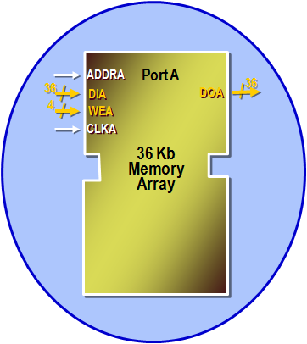
Single-Port Block RAM
Single read/write port
Clock: CLKA, Address: ADDRA, Write enable: WEA
Write data: DIA, Read data: DOA
36-kbit configurations
32k x 1, 16k x 2, 8k x 4, 4k x 9, 2k x 18, 1k x 36
18-kbit configurations
16k x 1, 8k x 2, 4k x 4, 2k x 9, 1k x 18, 512 x 36
Notes:
In addition to the signals shown above, the RAM port also has:
RAM enable: ENA
Output latch reset: RSTRAMA
Output register reset: RSTREGA
Output register chip enable: REGCEA
The optional output register adds one clock of read latency, but enables the highest clock frequencies
For simplicity, the DIA and DOA busses are shown as including the parity bits, which are actually on separate buses, DIPA and DOPA.
The polarity of the RST, CE, and CLK signals are programmable. The RST signals are synchronous.
The priority of REGCEA over RSTREGA is programmable via the RSTREG_PRIORITY attribute.
It is important to ensure that no timing violations occur on the address pins of the RAM, even if the write enable is not asserted. Violating address timing (even during a read operation) can corrupt the RAM contents.

Slide 28
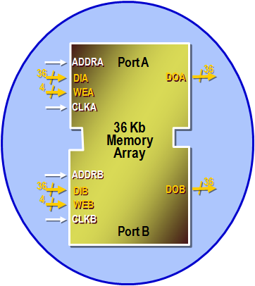
Dual-Port Block RAM
Two separate read/write ports
Each port has separate clock, address, data in, data out, write enable…
Clocks can be asynchronous to each other
The two ports can have different widths
Same configurations as when single ported
Notes:
Because the two ports can operate on independent clocks, it is up to the user to avoid contention. If both ports attempt to write to the same location “too close together”, the contents of that RAM location can be corrupted. If one port attempts to read from an address that is being written from the other port, the read result will be unpredictable.
In the special case where both ports are clocked by the same clock signal (that is, the two ports are synchronous), and the write port is in READ_FIRST mode, then the other port can read the old contents of a RAM location while the new value is being written.

Slide 29
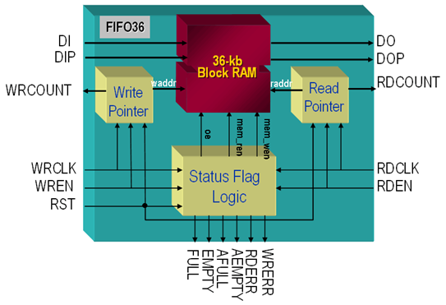
FIFO
Full featured
Synchronous or asynchronous read and write clocks
FIFO configurations
Any 36-Kb block RAM: 8Kx4, 4Kx9, 2Kx18, 1Kx36, 512x72
Any 18-Kb block RAM: 4Kx4, 2Kx9, 1Kx18, 512x36
Write and read width must be equal

Slide 30
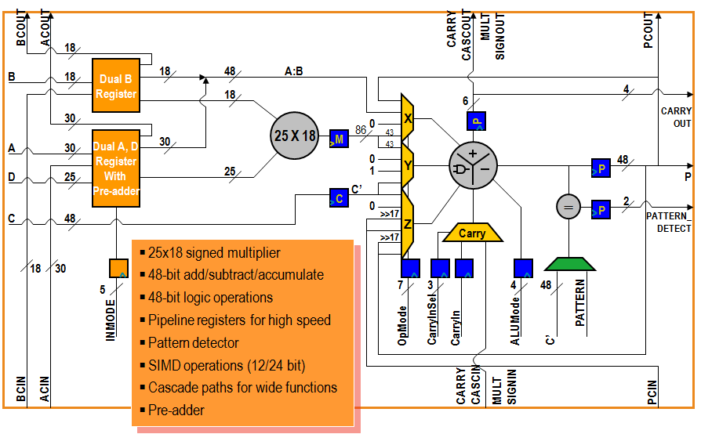
7-Series DSP48E1 Slice
Notes:
All 7-series FPGAs contain the same DSP48E1 slice. Only the number of slices and maximum frequency vary from family to family.
C’ denotes the output of the optional C pipeline register. This bus is one input of the pattern detect multiplexer; the other input is the 48-bit PATTERN attribute.
In order to implement most DSP functions, certain features are required of a DSP slice:
Input conditioning – including pre-addition and pipeline control.
Pipelining – for maximum performance and the implementation of sample delays (Z-1).
Multiplication – the basis of most DSP functions.
Operation control – to support different operations.
Addition – for multiply-accumulation.
Product register – for performance, sample delays, and accumulation.
Cascade paths (not shown) – for chaining together DSP slices.

Slide 31
Outline
Introduction to 7-Series FPGA
Logic Resources
I/O Resources
Memory and DSP48 Resources
XADC
Clocking Resources
Zynq SoC

Slide 32
XADC and AMS
XADC is a high quality and flexible analog interface new to the 7-series
Dual 12-bit 1Msps ADCs, on-chip sensors, 17 flexible analog inputs, and track & holds with programmable signal conditioning
1V input range
16-bit resolution conversion
Built in digital gain and offset calibration
Analog Mixed Signal (AMS)
Using the FPGA programmable logic to customize the XADC and replace other external analog functions; for example, linearization, calibration, filtering, and DC balancing to improve data conversion resolution
Notes:
The integration of the XADC block now allows FPGAs to support a general-purpose analog interface that can address a wide range of applications.
More importantly with the combination of the XADC with the programmable logic and resources in the FPGA, a highly customized analog interface can be implemented.
AMS is the combination of analog and programmable logic (WP398: Agile Mixed Signal Addresses Analog Design Challenges).

Slide 33
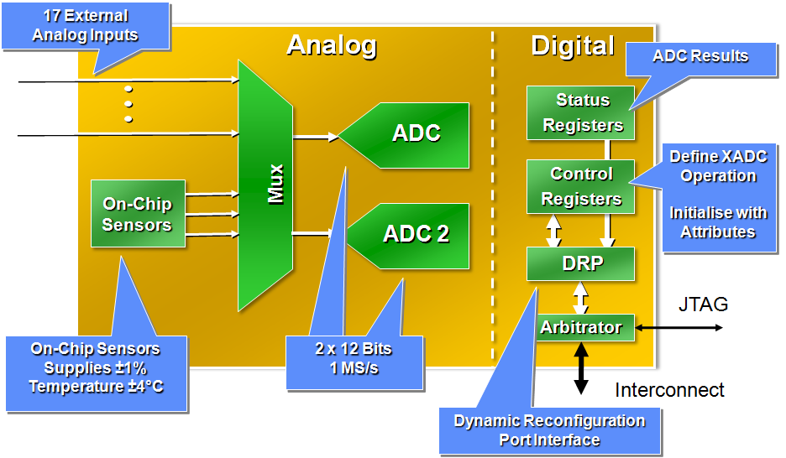
XADC Block Diagram
Fast sampling
Conversion time of 1 us with support for simultaneous sampling
Flexible timing modes (self and externally triggered sampling modes)
Separate track/hold amplifier for each ADC ensures maximum throughput using multiplexed analog input channels
Flexible analog inputs
Differential analog inputs with high common mode noise rejection
Support for unipolar, bipolar, and true differential input signal types

Slide 34
Outline
Introduction to 7-Series FPGA
Logic Resources
I/O Resources
Memory and DSP48 Resources
XADC
Clocking Resources
Zynq SoC

Slide 35
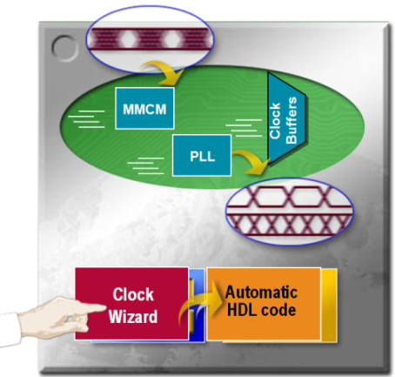
7-Series FPGAs Clock Management
Global clock buffers
High fanout clock distribution buffer
Low-skew clock distribution
Regional clock routing
Clock management tile (CMT)
One Mixed-Mode Clock Managers (MMCMs) and one Phase Locked Loop (PLL) in each Clock
Performs frequency synthesis, clock de-skew, and jitter-filtering
High input frequency range
Simple design creation through the Clocking Wizard

Slide 36
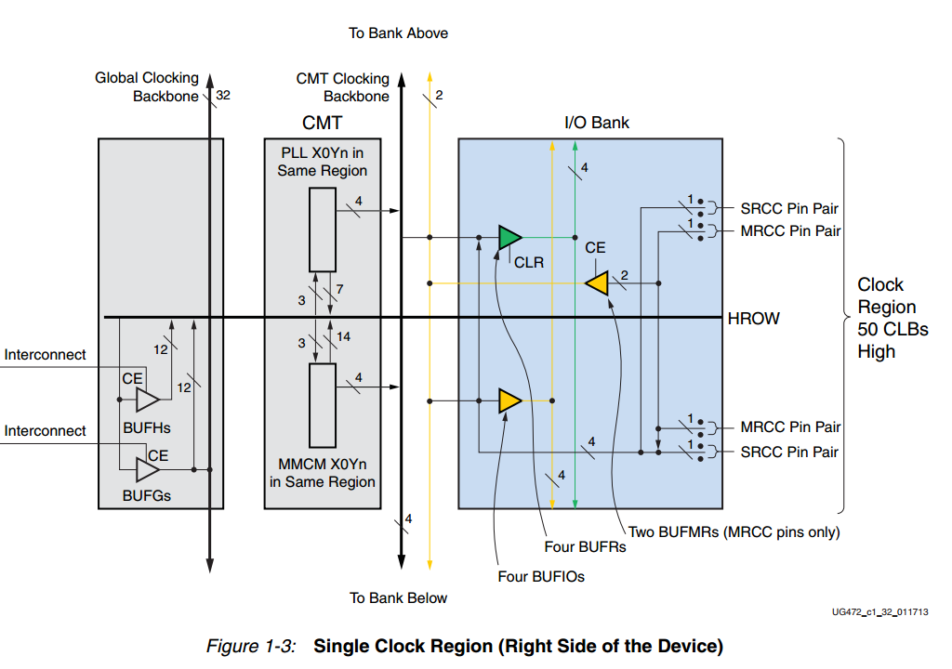
Clock-Capable Inputs
All synchronous designs need at least one external clock reference
These clocks need to be brought into the FPGA
Every 7-series FPGA has clock-capable inputs in every I/O bank
These inputs are regular I/O pins with dedicated connections to internal clock resources
Notes:
Clock-capable pins will have the identifier “CC” in their pin name.
An IBUFG or IBUFGDS primitive can be used in your HDL code to indicate that an input must be mapped to a clock-capable pin

Slide 37
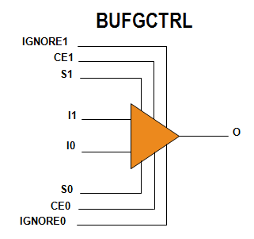
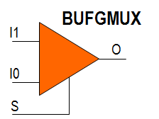
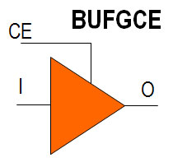
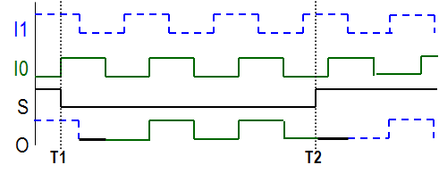
Global Clock Buffer (BUFGCTRL)
BUFGCTRLs (or BUFG) reside in the center of the device
BUFGCTRLs can be driven by
Clock-capable I/O (CCIO) in the same half
CMT outputs in the same half
Gigabit transceiver clocks in the same half
Other BUFG, interconnect, or BUFR
BUFGCTRL outputs drive the vertical global clock spine
BUFGCTRL component implements
Simple clock buffer (BUFG)
Clock buffer with clock switching (BUFGMUX or BUFGMUX_CTRL)
Clock buffer with clock enable (BUFGCE)

Slide 38
Outline
Introduction to 7-Series FPGA
Logic Resources
I/O Resources
Memory and DSP48 Resources
XADC
Clocking Resources
Zynq SoC

Slide 39
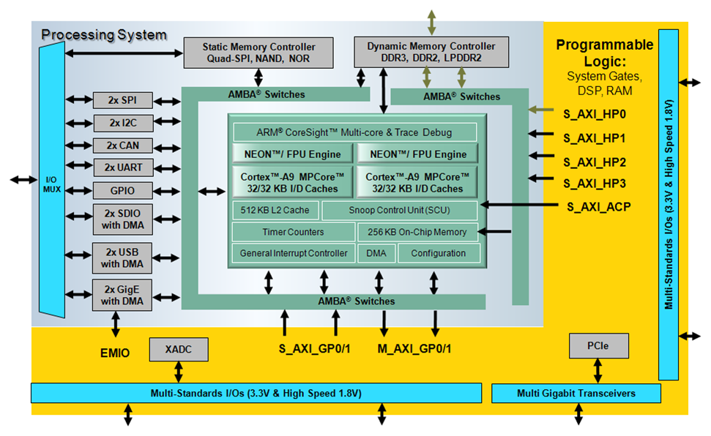
Zynq-7000 Family Highlights
Complete ARM®-based processing system
Application Processor Unit (APU)
Dual ARM Cortex™-A9 processors
Caches and support blocks
Fully integrated memory controllers
I/O peripherals
Tightly integrated programmable logic
Used to extend the processing system
Scalable density and performance
Flexible array of I/O
Wide range of external multi-standard I/O
High-performance integrated serial transceivers
Analog-to-digital converter inputs

