Slide 1
Power FET Structures (DMOS and VMOS) and Applications
By: Cody Neubarth
Date: 4/27/16
Abstract
Power MOSFETS are designed to handle significant power levels. It’s main advantages are its high commutation speed and good efficiency at low voltage levels. Power MOSFETS have a vertical structure rather than a planar structure.

Slide 2
Outline
DMOS
What is a DMOS?
DMOS Structure
DMOS Applications
VMOS
What is a VMOS?
VMOS Structure
VMOS Applications

Slide 3
DMOS what is it?
Double-diffused MOSFET (DMOS)
A power MOSFET in which the source and channel regions are formed using a double diffusion process
Used in switching applications with high voltage and high frequencies

Slide 4
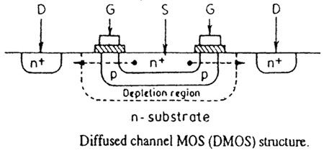
DMOS Structure
p-substrate region and the n+ source contact are diffused through a common window defined by edge of gate
p-base region is diffused deeper than the n+ source
Result: difference in the lateral diffusion distance between p-base and the source defines the surface channel length
http://www.circuitstoday.com/wp-content/uploads/2010/07/DMOS-Structure.jpg

Slide 5
DMOS Structure
Electrons enter the source terminal and flow laterally through the inversion layer under the gate to the n-drift region.
Once here the electrons flow vertically through the n-drift region to the drain terminal.
Conventional current direction is from the drain to the source.
Cross-section of DMOS
Semiconductor Physics and Devices textbook by Donald A. Neamen

Slide 6
DMOS Structure
DMOS similar to BJT
Important characteristic are the breakdown voltage and the on-resistance
A lightly doped drift region between the drain contact and the channel region helps ensure a very high breakdown voltage

Slide 7
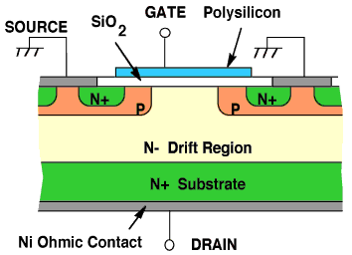
DMOS Structure
The n-drift region must be moderately doped so that the drain breakdown voltage is large
The thickness of the n-drift region should be as thin as possible in order to minimize drain resistance

Slide 8
Applications of DMOS
Automotive Control Applications
Power supplies
Inkjet print heads

Slide 9
VMOS what is it?
Named after V-shaped gate region
Vertical MOSFET with high current handling capability as well as high blocking voltage
Consists of a double diffused n⁺/p layer, which is cut by a V-shaped groove
Metalized area over the V-groove controls the current flow in the P region

Slide 10
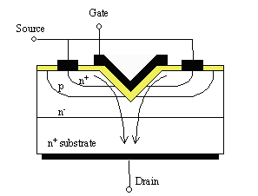
Structure of VMOS
V-groove cuts through the double diffused layer creating two vertical MOSFETs
Short gate length, which is determined by thickness of p-type layer
Vertical structure allows for use of low-doped drain region which results in a high blocking voltage
http://ecee.colorado.edu/~bart/book/book/chapter7/ch7_8.htm#7_8_2

Slide 11
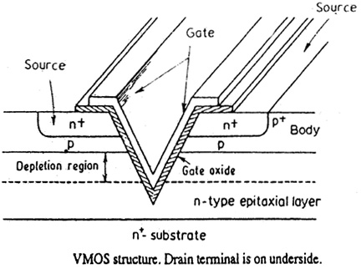
Structure of VMOS
V shape allows device to deliver higher amount of current from source to the drain
Shape of the depletion region creates a wider channel
The V-shaped gate increases the cross-sectional area of source-to-drain path

Slide 12
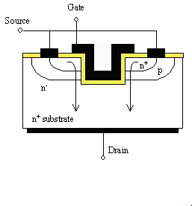
Structure of VMOS
Main drawback of VMOS:
Structure is more complicated than traditional FETs, making it more expensive.
UMOS
More cross-sectional surface area

Slide 13
Application of VMOS
Hi-fi audio power amplifiers
Broadband high frequency amplifiers
Switching power amplifiers

Slide 14
Summary
Power MOSETS have a vertical structure of both the DMOS and VMOS
Used in a variety of applications that desire increased switching speeds and a variety of voltage levels
Doping and channel lengths contribute to the characteristic of each of these MOSFETs

Slide 15
References
"Double-Diffused MOS (DMOS)." Electronic Circuits and Diagrams. N.p., 22 July 2011. Web. 216 Apr. 2016.
John. "V-Groove MOS (VMOS)." Circuits Today. 2015 Circuits Today, Feb. 9, 2011. Web. 15 April 2016.
Neamen, Donald A. "15.5 Power MOSFETs." Semiconductor Physics and Devices: Basic Principles fourth edition. New York, NY: McGraw-Hill, 2012. N. page 684-685. Print.
Poole Ian. "VMOS Field Effect Transistor." Radio-Electronics. Adrio Communications Ltd. Web. 13 April 2016.
"Power MOSFET." Wikipedia. 29 December 2015. Web. 13 April 2016.
Van Zeghbroeck, Bart. "Chapter 7: MOS Field-Effect- Transistors." Power MOSFETs. N.p., 2011. Web. 16 April 2016.

Slide 16
Five Key Points
Main advantages are high commutation speed and good efficiency at low voltages
Power MOSFETS have a vertical structure rather than planar
DMOS uses double diffusion process
V-shaped gate in VMOS increases cross-sectional area of the source-to-drain path
Most important characteristics are the breakdown voltage and the on-resistance

