Slide 1
VPNs
Concepts I

Slide 2
Taxonomy
By service definition
CPE-based
Provider-Provisioned
By sides
Site-to-Site
Remote Access (roadwarrior)
By topology
Hub and Spoke
Mesh
Mixed
By protocols
PPTP
L2TP
IPSEC
SSL
MPLS – L2, L3, VPLS, EVPN
GRE
IPIP
others

Slide 3
VPN types examples
CPE-based
PPTP
Windows VPN, PopTop.
L2TP (over IPSEC Transport)
Cisco, Mikrotik, Windows, etc.
IPSEC (tunnel mode)
Cisco, Juniper, Open/Free-swan, Windows (limited support), etc.
SSL
Pulse Secure, Cisco, Juniper, OpenVPN, etc.
Others
SSH tunnels, TOR, etc.
PP-VPNs – usually over MPLS
L3VPNs
L2VPNs
L2circuits
VPLS
EVPN

Slide 4
VPN concepts I
CPE-Based VPNs

Slide 5
VPN Concepts
Define virtual private network
List three security concerns and describe how to address them
List the components of the IPSec protocol suite
Explain the IKE protocol process for tunnel establishment

Slide 6
VPN Protocols
There are three main protocols that power the vast majority of VPN’s:
PPTP
L2TP
IPsec
SSL
All three protocols emphasize encryption and authentication; preserving data integrity that may be sensitive and allowing clients/servers to establish an identity on the network

Slide 7
More on Tunneling
Tunneling involves the encapsulation, transmission and decapsulation of data packets
The data is encapsulated with additional headers
The additional headers provide routing information for encapsulated data to be routed between the end points of a tunnel

Slide 8
Layer 2 Tunneling Protocols
PPTP
L2TP
Both encapsulate the payload in a PPP frame

Slide 9
Tunneling Protocols cont.
Each are built on PPP (Point to Point Protocol)
4 Phases
1) Link Establishment - a physical link between ends
2) User Authentication – Password protocols used
PAP, CHAP, MS-CHAP
3) Call Back Control – optional
Disconnects and server calls back after authentication
4) Data Transfer Phase – exactly what it sounds like

Slide 10
PPTP Data Encapsulation
IP addresses based on private network
IP
GRE
PPP
IP
TCP
UDP
User Data
Original IP Datagram
IP addresses based on transit network
Encrypted PPP Payload

Slide 11
L2TP/IPSec Data Encapsulation
IP addresses based on private network
L2TP – without encryption
IP
UDP
L2TP
PPP
IP
TCP
UDP
User Data
IP addresses based on transit network
Original IP Datagram
IP addresses based on private network
L2TP – With IPSec encryption
IP
IPSec
ESP
Header
UDP
L2TP
PPP
IP
TCP
UDP
User Data
IPSec
ESP
Trailer
IPSec
AUTH
Trailer
IP addresses based on transit network
Original IP Datagram
Original IP Datagram
Encrypted with IPSec

Slide 12
Windows Implementation of VPN
L2TP for tunneling
IPSec for encryption
Known as L2TP/IPSec

Slide 13
Layer 3 Tunneling Protocol
IPSec Tunneling Mode
Encapsulates the payload in an additional IP header

Slide 14
Virtual Private Networks
Virtual Private Networks (VPNs) provide a secure path for communication between private sites via a public network
Connection provided via a tunnel
Private data is encapsulated in packets between public gateways
Various tunnel protocols
GRE
L2TP
PPTP
IPSEC
R E M O T E O F F I C E
C O R P O F F I C E
A
X
Y
B
From A to B
From X to Y
From A to B
From A to B

Slide 15
Data Encryption
Provides data confidentiality
Data is encrypted and decrypted by using keys
Symmetric (secret) key
Asymmetric (public) key
Data encryption is a reversible process

Slide 16
Symmetric Key Encryption
Symmetric keys are faster and used for bulk data encryption
Typical key size vary from 40bits to 1024 bits
Examples: DES, 3DES, AES
Sender
Receiver
1
Original data
+
Encrypted data
+
2
Encrypted data
3
Original data

Slide 17
Public Key Encryption
Slow when used for data encryption
Typical sizes range from 512 bits to 2048 bits
Examples: RSA, DH
Receiver
Sender
Encrypted data
1
Original data
+
Priv
Pub
Get public key
for source
3
2
Pub
Encrypted data
+
4
Encrypted data
Original data

Slide 18
Data Integrity
Hash functions are used to provide integrity services
One-way hashing algorithm – cannot determine original data from hash value
Fixed-length output (depending on algorithm)
Examples
MD5, SHA
MD5 provides 128 bit output
SHA provides 160 or 256 bit output

Slide 19
One-Way Hash Algorithms
Example: a modulus operation
Given the value “3”, what was the original data?
Hash functions can use the modulus operation in the hash creation process
80mod11 = = 3
7 r3
11 80
77
3
80mod11 = 3
13mod5 = 3
203mod10 = 3
11mod8 = 3
100mod97 = 3

Slide 20
Hash Process
Sender
Receiver
Data
HASH
Data
3
2
Data
HASH
1
4
Data
HASH
HASH
5
HASH
If the hash values match, the data is good
If the hash values match, the data is good

Slide 21
Source Authentication
Validates datagrams by verifying they came from the proper source
The authentication process uses Hashing Message Authentication Code (HMAC)
Adds a secret pre-shared key to the hashing process

Slide 22
Hashed Message Authentication Code (HMAC)
Sender
Receiver
Data
HASH
Data
+
Hash Key
3
2
Data
Hash Key
+
HASH
1
4
Data
HASH
HASH
5
HASH
If the hash values match, the data is good and the source is valid
If the hash values match, the data is good

Slide 23
How Do Keys Get Exchanged?
Encryption and hashing both rely on keys
Manual configuration
Prone to configuration errors
Rarely changed
Automatic exchange
Uses public connections – how to secure the key exchange?
The Solution: Diffie-Hellman Key Exchange Algorithm
First published public key cryptography standard
Solves the key distribution problem through use of public/private key pairs
Only public key sent across the network

Slide 24
Diffie-Hellman Groups
5 sets of very large Prime numbers (and a generator) used as the modulus for the Diffie-Hellman algorithm
I.e. Groups 1, 2 and 5
Group 1 uses a 768-bit prime
Group 2 uses a 1024-bit prime
Group 5 uses a 1536-bit prime

Slide 25
The DH Key Exchange Process
PrivA
PrivB
Each device generates a public and private key pair
PubA
PubB
Public keys are exchanged
Local private and remote public are combined to form session key
SESSION
KEY

Slide 26
IP-Security
IP-Security (IPSec) is an industry standard for providing IP data security and integrity services
Works at IP Layer
Supports unicast traffic
IPSec uses two protocols to provide traffic security
Encapsulating Security Payload – ESP
Confidentiality
Integrity
Authentication
Authentication Header – AH
Integrity
Authentication
Without encryption

Slide 27
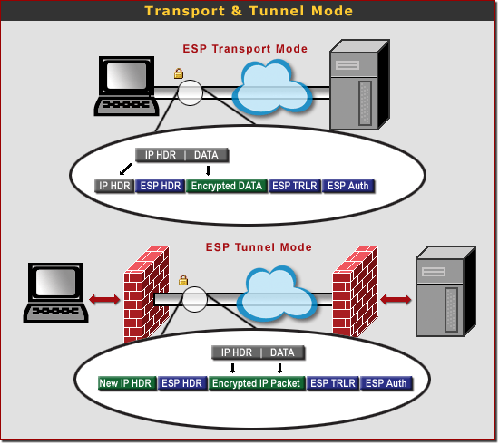
IPSec Modes
Tunnel mode
New IP Header
Tunnel
Transport mode
Used to encrypt communication
Often with another tunneling protocol (as L2TP)

Slide 28
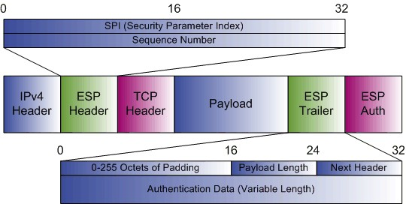
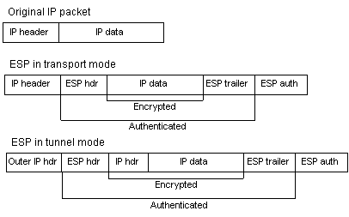
Encapsulating Security Payload – ESP
Defined in RFC 2406
Protocol number 50
Provides
Data confidentiality
Data integrity
Data origin authentication
Anti-replay services
Can be used in tunnel and transport mode

Slide 29
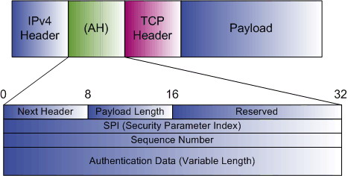
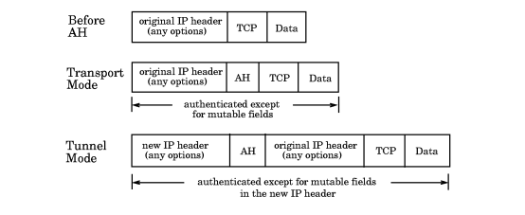
Authentication Header – AH
Defined in RFC 2402
Protocol number 51
Provides
Data integrity
Data origin authentication
Anti-Replay services
Can be used in tunnel and transport mode
No encryption

Slide 30
IPSEC and NAT – NAT Traversal
Outer encapsulation
UDP 500 (send-receive) - for authentication
UDP 4500 (NAT-T v.2)
Simply enable it on the Gateway, if not by default
UDP checksum – disabled

Slide 31
Tunnel Establishment using Internet Key Exchange
The Internet Key Exchange (IKE) provides increased functionality in secure environments
Protocol UDP, port 500
Establishes Security Associations for creating IPsec VPN tunnels
Negotiates proposals containing encryption and authentication algorithms
Creates Encryption and Authentication Keys automatically which provides ability to be re-keyed frequently
Provides gateway identity function

Slide 32
Security Associations (SA)
Security Associations are set of policies and keys used to protect information between two peers
SA is uniquely identified by
SPI
Destination IP address
Security protocol (ESP/AH)
SAs are established during IPSec Phase 1 and Phase 2 negotiations
Phase 1 SA is bi-directional and Phase 2 SA is unidirectional

Slide 33
SA Database
R E M O T E O F F I C E
Untrust
1.1.8.1
Trust
10.10.0.1
10.0.0.5
10.0.0.6
10.10.0.5
10.10.0.6
Trust
10.0.0.1
Untrust
2.2.8.1
C O R P O F F I C E
Security Database
Name: VPNtoCorporate Gateway IP: 2.2.8.1
Security Index (SPI) local: 3001, remote: 3002 Security Protocol: ESP
Encryption Alg: 3DES
Encryption Key: xxxxyyyyzzzz
Authentication Alg: SHA
Authentication key: aaabbbccc
Security Database Name: VPNtoRemote
Gateway IP: 1.1.8.1
Security Index (SPI) local: 3002, remote: 3001 Security Protocol: ESP
Encryption Alg: 3DES
Encryption Key: xxxxyyyyzzzz
Authentication Alg: SHA
Authentication key: aaabbbccc

Slide 34
IKE Phases
Phase 1
Two peers establish a secure, authenticated channel with which to communicate
Diffie-Hellman key exchange algorithm is used to generate a symmetric key common to the communicating gateways
Runs in one of two modes
Main mode – used when both tunnel peers have static IP addresses
Aggressive mode – used when one tunnel peer has a dynamically-assigned IP address
Phase 2
Security Associations are negotiated using a Phase 1 secure channel
Proxy-ID used to identify which SA is referenced for VPN
Diffie-Hellman key exchange algorithm may be used (again) to create perfect forward secrecy (PFS)
Phase 2 mode is called Quick Mode

Slide 35
IKE Phase 1 : Main Mode
Remote
NetScreen
Corporate
NetScreen
E1: E8:
10.1.10.1 1.1.8.1
E8: E1:
2.2.8.1 10.1.210.1
10.1.210.5
10.1.10.5
Message 1:
Cookie I, SA Proposal List
Message 3:
DH Public Value A, Nonce I (Random #)
Message 5:
Identification I, Identification Hash I
Message 2:
Cookie I, Cookie R, SA Proposal Accept
Message 4:
DH Public Value B, Nonce R (Random #)
Message 6:
Identification R, Identification Hash R
Encrypted and Authenticated

Slide 36
IKE Phase 1: Aggressive Mode
Remote
NetScreen
Corporate
NetScreen
E1: E8:
10.1.10.1 (dynamic)
E8: E1:
2.2.8.1 10.1.210.1
10.1.210.5
10.1.10.5
Message 1:
Hdr, SA Proposal List, DH Public Value A, Nonce I
Message 3:
Identification Hash I
Message 2:
Hdr, SA Proposal Accept, DH Public Value B, Nonce R, Identification Hash R
Encrypted and Authenticated

Slide 37
IKE Phase 2: Quick Mode
Remote
NetScreen
Corporate
NetScreen
E1: E8:
10.1.10.1 1.1.8.1
E8: E1:
2.2.8.1 10.1.210.1
10.1.210.5
10.1.10.5
Message 1:
Hash using Phase 1 information,
Message ID, SA Proposal List, Nonce I,
[DH Public Key I ], Proxy ID
Message 3:
Hash using Phase 1 information,
Message ID, Nonce I, Nonce R
Message 2:
Hash using Phase 1 information,
Message ID, SA Proposal List Accept,
Nonce R, [DH Public Key I ], Proxy ID

Slide 38
Proxy-ID
Locally generated Phase 2 IKE ID
Proxy-ID used to identify which SA is referenced for VPN
Used to link particular subnets to the same single VPN
2 values for every VPN
Local Proxy-ID
Must match Remote Proxy-ID of peer
Remote Proxy-ID
Must match Local Proxy-ID of peer
Policy Checking
Use if configuration on the peer gateways support multiple tunnels. Otherwise, the IKE session will fail
You can disable policy checking when only one policy is configured between two peers.

Slide 39
IPSec Tunnel Establishment – Summary
Remote
NetScreen
Corporate
NetScreen
E1: E8:
10.1.10.1 1.1.8.1
E8: E1:
2.2.8.1 10.1.210.1
10.1.210.5
10.1.10.5
Phase 1
Hdr,SA,DH
Hdr,SA,DH
Phase 2
SA,proxy id
SA,proxy id
IPSec tunnel
Data
Data

Slide 40
Packet Handling
Remote
NetScreen
Corporate
NetScreen
A
B
E1: E8:
10.1.10.1 1.1.8.1
E8: E1:
2.2.8.1 10.1.210.1
10.1.210.5
10.1.10.5
1
10.1.10.5
10.1.210.5
2
Network Int Gate
10.1.210.5 e8 1.1.8.254
3
From trust to untrust 10.1.10.5 10.1.210.5 tunnel
4
10.1.10.5
10.1.210.5
5
10.1.10.5
10.1.210.5
HASH
6
1.1.8.1
2.2.8.1
50
SPI
10.1.10.5
10.1.210.5
HASH

Slide 41
Packet Handling (cont.)
Remote
NetScreen
Corporate
NetScreen
A
B
E1: E8:
10.1.10.1 1.1.8.1
E8: E1:
2.2.8.1 10.1.210.1
10.1.210.5
10.1.10.5
7
1.1.8.1
2.2.8.1
50
SPI
10.1.10.5
10.1.210.5
HASH
8
SPI Encap Encryp Auth
3001 ESP AES SHA
9
HASH
=
HASH
10
10.1.10.5
10.1.210.5
10.1.10.5
10.1.210.5
11
Network Int Gate
10.1.210.5 e1 0.0.0.0
12
From untrust to trust 10.1.10.5 10.1.210.5 any tunnel

Slide 42
SSL Based VPNs
Browser based
PositivePRO – Positive Networks Connectra – Checkpoint Software
No special client needed
can be used on any device that is web enabled that supports SSL (PDA, Cell phones...)
OS independent
Can’t access desktop applications
Netifice
Browser based
Java Agent Based
SSL Windows client for desktop access
SSL-Explorer – Open Source
Pulse secure
Secure Web Application Access
Support for widest range of web-based content and applications like Sharepoint, OWA, iNotes, PDF, Flash, Java applets, HTML, Javascript, DHTML, VBScript, XML, etc.
Host & deliver any Java applet
Secure File Share Access
Web front-end for Windows and Unix Files (CIFS/NFS)
Integrated E-mail Client
Secure Terminal Access
Access to Telnet/SSH (VT100, VT320…)
Anywhere access with no terminal emulation client
Secure Virtual Workspace
Network Connect
Full Layer 3 Access, similar to IPSec VPN
Adaptive, Dual Transport Mode
Initially attempts to set up high performance, IPSec transport
If blocked by network, seamlessly fails over to SSL
Cross Platform Dynamic Download (A|X or Java delivery)
Range of options – browser launch, standalone EXE, scriptable launcher, MSFT Gina
Client-side Logging, Auditing and Diagnostics

Slide 43
SSL Based VPNs
Non-browser based
OpenVPN
requires client software be installed for each user
Open Source (free)
very good track record (Since 2002)
Runs on most OSs
compatible with with:
SSL/TLS
RSA Certificates
X509 PKI
NAT
DHCP
TUN/TAP virtual devices

Slide 44
Summary
In this module we covered
Tunnel concepts
Different methods of data encryption and hashing
The components of the IPSec protocol suite
The IKE protocol process for tunnel establishment

