Slide 1
NAT

Slide 2
Agenda
NAT and NAPT
  Types of NATs
Application Impact
  Application Layer Gateway (ALG)
  STUN, ICE, TURN
Large-Scale NATs (LSN, CGN, SP NAT)
IPv6/IPv4 Translation (“NAT64”)
NAT66

Slide 3
Private Network
Private IP network is an IP network that is not directly connected to the Internet
IP addresses in a private network can be assigned arbitrarily.
  Not registered and not guaranteed to be globally unique
Generally, private networks use addresses from the following experimental address ranges (non-routable addresses):
  10.0.0.0 – 10.255.255.255
  172.16.0.0 – 172.31.255.255
  192.168.0.0 – 192.168.255.255

Slide 4
Private Addresses

Slide 5
NAT
First described in 1991
1:1 translation
  Does not conserve IPv4 addresses
Per-flow stateless
Today’s primary use is inside of enterprise networks
  Connect overlapping RFC1918 address space

Slide 6
Network Address Translation (NAT)
RFC 1631
A short term solution to the problem of the depletion of IP addresses
  Long term solution is IP v6
  CIDR (Classless InterDomain Routing ) is a possible short term solution
  NAT is another
NAT is a way to conserve IP addresses
  Can be used to hide a number of hosts behind a single IP address
  Uses private addresses:
    10.0.0.0-10.255.255.255,
    172.16.0.0-172.32.255.255 or
    192.168.0.0-192.168.255.255

Slide 7
NAT Diagram
Hosts seem to have multiple IPv4 addresses – almost like “ghosts”
192.168.0.2
10.1.1.2
192.168.0.1
10.1.1.1
192.168.0.3
10.1.1.3

Slide 8
NAPT
Described in 2001 (RFC3022)
1:N translation
  Conserves IPv4 addresses
  Allows multiple hosts to share one IPv4 address
  Only TCP, UDP, and ICMP
  Connection has to be initiated from ‘inside’
Per-flow stateful
Commonly used in home gateways and enterprise NAT

Slide 9
NAPT Diagram
Hosts share an IPv4 address
192.168.0.2
157.55.0.1
Internet
192.168.0.3
192.168.0.1

Slide 10
NAPT complications
NAPT requires connections initiated from ‘inside’
Creates state in the network (in the NAPT)
  This is bad
  NAPT crashes -> connections break
When to discard state?
  TCP RST? Spoofed RSTs?
  Timeout?

Slide 11
Terminology
“NAT” is spoken/written instead of “NAPT”
  Even though NAPT is often more accurate
  The more accurate “PAT” never caught on
So, it’s “NAT”
Now, often called “NAT44” to differentiate from NAT64 and NAT46

Slide 12
Basic Operation of NAT
NAT device has address translation table
One to one address translation

Slide 13
Pooling of IP Addresses
Scenario: Corporate network has many hosts but only a small number of public IP addresses
NAT solution:
  Corporate network is managed with a private address space
  NAT device, located at the boundary between the corporate network and the public Internet, manages a pool of public IP addresses
  When a host from the corporate network sends an IP datagram to a host in the public Internet, the NAT device picks a public IP address from the address pool, and binds this address to the private address of the host

Slide 14
Pooling of IP Addresses

Slide 15
Supporting Migration between network service Providers

Slide 16
IP Masquerading
Also called: Network address and port translation (NAPT), port address translation (PAT).
Scenario: Single public IP address is mapped to multiple hosts in a private network.
NAT solution:
  Assign private addresses to the hosts of the corporate network
  NAT device modifies the port numbers for outgoing traffic

Slide 17
IP Masquerading

Slide 18
Load Balancing of Servers
Scenario: Balance the load on a set of identical servers, which are accessible from a single IP address
NAT solution:
  Here, the servers are assigned private addresses
  NAT device acts as a proxy for requests to the server from the public network
  The NAT device changes the destination IP address of arriving packets to one of the private addresses for a server
  A sensible strategy for balancing the load of the servers is to assign the addresses of the servers in a round-robin fashion.

Slide 19
Load Balancing of Servers

Slide 20
NAT Philosophy
“Be transparent”
This means it isn’t a proxy
  Applications are generally unaware of a NAT
Problem with IP addresses inside the application
  Generally called a “referral”
  Example: SIP
Internet
“my address is 10.1.1.1”
Internet sees 161.44.1.1

Slide 21
NAPT and servers
NAPT: connection initiated from inside
Incoming connections are difficult
Significant problem for servers
  Webcam, VoIP, RTSP receivers, etc.
Port forwarding (“pinholing”, etc.)
  web or CLI configuration
  UPnP IGD, NAT-PMP
  All have drawbacks

Slide 22
Concerns about NAT
Performance:
  Modifying the IP header by changing the IP address requires that NAT boxes recalculate the IP header checksum
  Modifying port number requires that NAT boxes recalculate TCP checksum
Fragmentation
  Care must be taken that a datagram that is fragmented before it reaches the NAT device, is not assigned a different IP address or different port numbers for each of the fragments.

Slide 23
Concerns about NAT
End-to-end connectivity:
  NAT destroys universal end-to-end reachability of hosts on the Internet.
  A host in the public Internet often cannot initiate communication to a host in a private network.
  The problem is worse, when two hosts that are in a private network need to communicate with each other.

Slide 24
Concerns about NAT
IP address in application data:
  Applications that carry IP addresses in the payload of the application data generally do not work across a private-public network boundary.
  Some NAT devices inspect the payload of widely used application layer protocols and, if an IP address is detected in the application-layer header or the application payload, translate the address according to the address translation table.

Slide 25
Brief Overview of FTP
RFC 959
Uses two TCP Ports
  One for control
  One for data transfers
Command-response protocol
Control port uses telnet protocol to negotiate session
  US-ASCII
  <crlf> is end-of-line character

Slide 26
Active Mode FTP
Client connect from a random unprivileged port (n > 1023) to the servers command port (21) and sends port command to tell server to connect to n+1 then listens on the next higher unprivileged port (n+1) for server responses. The server connects from it’s data port (20) to the client data port (n+1).
Server
Client
20
21
1026
1027
1
2
3
4

Slide 27
Passive Mode FTP
Client opens two random unprivileged ports ( n > 1023 and n+1; for example 1026 and 1027) and connects the first port (n) to server command port 21 and issues a pasv command (server sends port to use for data); client connects to servers specified data port, server completes connection.
Server
Client
20
2024
21
1026
1027
1
2
3
4

Slide 28
NAT and FTP
Normal FTP operation

Slide 29
NAT and FTP
NAT device with FTP support

Slide 30
NAT and FTP
FTP in passive mode and NAT.

Slide 31
NAT Supported Traffic Types
Traffic Types/Applications Supported
Traffic Types/Applications not Supported
Any TCP/UDP Traffic that Does Not Carry Source and/or Destination IP Addresses in the Application Data Stream
IP Multicast
HTTP
Routing Table Updates
TFTP
DNS Zone Transfers
Telnet
BOOTP
archie
Talk, Ntalk
finger
H.323
NTP
VDOLive
NFS
NetShow
rlogin, rsh, rcp
VXtreme
Although the Following Traffic Types Carry IP
Addresses in the Application Data Stream, they
are Supported by Cisco IOS NAT:
SNMP
ICMP
SMTP
FTP (Including PORT and PASV Commands)
NetBIOS over TCP/IP
Progressive Networks?RealAudio
White Pines CuSeeMe
DNS "A" and "PTR" Queries
Xing Technologies StreamWorks

Slide 32
Application Layer Gateway (ALG)
Application awareness inside the NAT
ALG modifies IP addresses and ports in application payload, and creates NAT mapping
Each application requires a separate ALG
  FTP, SIP, RTSP, RealAudio, …
Internet
NAT with
SIP ALG
m/c=10.1.1.1/1234
m/c=161.44.1.1/5678

Slide 33
Problems with ALGs
Requires ALG for each application
Requires ALG that understands this particular application’s nuance
  Proprietary extensions / deviations
  New standard extensions
ALG requires:
  Un-encrypted signaling (!)
  Seeing application’s signaling and media/data
    easy with stub network; harder with mesh network

Slide 34
Application Solutions
Applications cannot successfully rely on ALGs
So, Applications have developed their own solutions
FTP PASV
  Data connection always to server. Has security side-effects.
ICE, STUN, TURN
  Intelligence in endpoint
  Useful for offer/answer protocols (SIP, XMPP, probably more)
  Standardized in MMUSIC and BEHAVE
  (more on next slides)
RTSP supports ‘interleaved data’ (RFC2326)
  Streaming over RTSP’s TCP control channel
RTSPv2 with ICE-like NAT traversal
HTTP delivery
  Flash (e.g., YouTube)

Slide 35
STUN, ICE, TURN
Request/response protocol, used by:
  STUN itself (to learn IP address)
  ICE (for connectivity checks)
  TURN (to configure TURN server)
The response contains IP address and port of request
  Runs over UDP (typical) or TCP, port 3478
Think http://whatismyip.com

Slide 36
STUN, ICE, TURN
Procedure for Optimizing Media Flows
Defines SDP syntax to indicate ‘candidate addresses’
Uses STUN messages for connectivity checks
  Sent to RTP peer, using same ports as RTP
First best path wins
Think: gather all my IP addresses, send them to my peer, and do connectivity checks

Slide 37
STUN, ICE, TURN
Media Relay Protocol and Media Relay Server
Only used when:
  both endpoints are behind ‘Address and Port-Dependent Filtering’ NATs (rare, about 25% of NATs), or
  one endpoint doesn’t implement ICE, and is behind a ‘Address and Port-Dependent Filtering’ NAT

Slide 38
ICE Deployments
Google chat (XMPP)
Microsoft MSN
Yahoo
Counterpath softphone

Slide 39

NAT444 = NAT44 + NAT44
Large-Scale NAT
(LSN)
IPv4_{private}
IPv4_{private}
IPv4
Internet
NAT44
NAT44
Home network
ISP network

Slide 40
Large Scale NAT (LSN)
Essentially, just a big NAPT44
Needs per-subscriber TCP/UDP port limits
  Prevent DoS
  If too low, can interfere with applications
    Classic example: Google maps
How to number network between subscriber and LSN?
  RFC1918 conflicts with user’s space, breaks some NATs
  Using routable IPv4 addresses is … wasteful

Slide 41
LSN and ALG
Operationally complex in a LSN
    Application X works but Application Y breaks. Upgrade ALG??
    How long is vendor turn-around for patches?
Interfering with competitor’s over-the-top application (e.g., SIP, streaming video)

Slide 42
IPv4 Address Sharing
Problem most noticed with LSN
Reputation and abuse reporting are based on IPv4 address
  Shared IP address = shared suffering
  Law Enforcement
  “Which subscriber posted on www.example.com at 8:23pm?”
  Requires LSN log source port numbers
  Requires web servers log source port numbers
Everybody can’t get port 80
Geo-location breaks
draft-ford-shared-addressing-issues

Slide 43
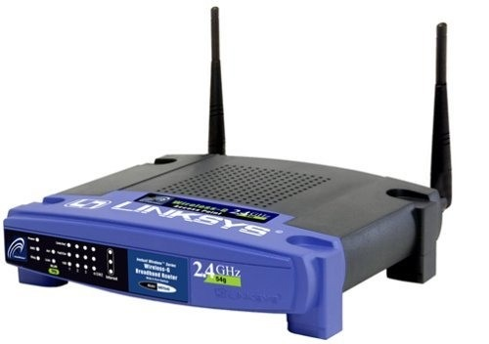
The Ideal IPv6/IPv4 Translation
IPv6 Internet
IPv4 Internet

Slide 44
Translation versus Tunneling
If you have a choice, tunnel
  6rd (IPv6 over IPv4)
  Dual-Stack Lite (IPv4 over IPv6)
Translate only when crossing between address families
  IPv4-only host to IPv6-only host
  IPv6-only host to IPv4-only host

Slide 45
Then, Why Translate?
Exhaust IPv4 addresses in 2011-2012
Need to access IPv4-only content from IPv6-only clients
Long tail of IPv4-only content
  Children’s soccer practice schedule
Longer term: need to access IPv6-only servers from IPv4-only clients

Slide 46
NAT-PT
NAT-PT combined all scenarios
  IPv4 to IPv6 is problematic; IPv6 space is bigger
  Broke DNSSEC
RFC4966 said IPv6/IPv4 translation causes other side effects
  And some are not solvable
But:
IPv4 addresses running out
Effectively no IPv6 Internet access and no IPv6 content anywhere in the world
We can’t tunnel everywhere

Slide 47
Translation Evolution S-Curve
Mostly IPv6 content
Dominant Scenario:
IPv4 clients to IPv6 servers
Content providers realize IPv6 avoids NAT64
“The (IPv4) Internet Is Full”
RIR IPv4 exhaustion
Google/Youtube
Dominant Scenario:
IPv6 clients to IPv4 servers
Mostly IPv4 content
2009
2011-2012
20??

Slide 48
IPv6/IPv4 Translation: some detail
Connecting an IPv6 network to the IPv4 Internet
  You built an IPv6-only network, and want to access servers on the IPv4 Internet
Connecting the IPv6 Internet to an IPv4 network
  You have IPv4 servers, and want them available to the IPv6 Internet
Connecting the IPv4 Internet to an IPv6 network
  You built an IPv6-only network, and want its servers available to the IPv4 Internet

Slide 49
Connecting an IPv6 network to the IPv4 Internet
IPv6
Internet
DNS64
IPv6/IPv4 Translator
(“NAT64”)
IPv4
Internet
IPv6-only clients
An IPv6 network
Internet

Slide 50
DNS64
Synthesizes AAAA records when not present
  With IPv6 prefix of NAT64 translator
Works for applications that do DNS queries
Breaks for applications that don’t

Slide 51
IPv6/IPv4 Translation
Stateless
1:1 translation
“NAT”
Any protocol
No IPv4 address savings
  Just like dual-stack
Stateful
1:N translation
“NAPT”
TCP, UDP, ICMP
Saves IPv4 addresses

Slide 52
IPv6/IPv4 translation issues
IPv4 address literals
  http://1.2.3.4
  SIP, RTSP, SAP
IP Family sensitive protocols
  FTP (EPSV, PASV)
How to resolve?
  Application proxies, make application smarter, ALG (FTP64)

Slide 53
Connecting the IPv6 Internet to an IPv4 network
Stateful
IPv6/IPv4 Translator
IPv6
Internet
IPv4-only hosts
An IPv4 network
Internet

Slide 54
Connecting the IPv6 Internet to an IPv4 network
Makes IPv4-only servers accessible on the IPv6 Internet
Requires stateful translation
  Because IPv6 Internet is bigger than IPv4
  (can’t represent every address in IPv4)
All connections come from translator’s IPv4 address
  Problem for abuse logging
  Lack of X-Forwarded-For: header
Maybe application proxy is superior?
  E.g., lighthttpd
  But has poor TLS interaction

Slide 55
Later IPv6/IPv4 Scenarios

Slide 56
Connecting the IPv4 Internet to an IPv6 network
DNS46 or normal DNS
Stateless
IPv6/IPv4 Translator
IPv4
Internet
IPv6-only servers
An IPv6 network
Internet

Slide 57
Connecting the IPv4 Internet to an IPv6 network
Stateless works well, one IPv4 address for each IPv6 server
  Same IPv4 consumption as dual-stack
Just like with NAT64 case, don’t use IPv6 address literals
  IPv4-only client can’t understand them!

Slide 58
NAT66
This is not NAPT66
NAT66 is 1:1 translation
  “IPv6 prefix rewriting”
No per-flow state in the NAT66 device
No manipulation of TCP or UDP headers
“But, we don’t need NAT with IPv6”

Slide 59
Multi-homed with Provider-Dependent (PD) addresses
Can’t get PI space
Don’t want Provider-Dependent space internally
  renumbering, ACLs
Lack of RFC4191 support in hosts
3GPP and work-at-home VPN tunnels
Provider-dependent
address
NAT66
ISP-A
IPv6
Internet
NAT66
ISP-B
One IPv6 address

Slide 60
Summary
NAT and NAPT
  Types of NATs
Application Impact
  Application Layer Gateway (ALG)
  STUN, ICE, TURN
Large-Scale NATs (LSN, CGN, SP NAT)
IPv6/IPv4 Translation (“NAT64”)
NAT66

Slide 61
Firewall Programs
Ipfwadm : Linux kernel 2.0.34
Ipchains : Linux kernel 2.2.*
Iptables : Linux kernel 2.4.*

Slide 62
Ipchains Packet Traversal

Slide 63
Iptables Packet Traversal

Slide 64
Configuring NAT in Linux
Linux uses the Netfilter/iptable package to add filtering rules to the IP module

Slide 65
Iptables NAT Overview
Source NAT
  The source address of the initial packet is modified.
  Performed on the POSTROUTING Chain.
  Includes MASQUERADE functionality.
Destination NAT
  The destination address of the initial packet is modified.
  Performed on the PREROUTING or OUTPUT chain.

Slide 66
Configuring NAT with iptables
First example:
iptables –t nat –A POSTROUTING –s 10.0.1.2
–j SNAT --to-source 128.143.71.21
Pooling of IP addresses:
iptables –t nat –A POSTROUTING –s 10.0.1.0/24
–j SNAT --to-source 128.128.71.0–128.143.71.30
ISP migration:
iptables –t nat –R POSTROUTING –s 10.0.1.0/24
–j SNAT --to-source 128.195.4.0–128.195.4.254
IP masquerading:
iptables –t nat –A POSTROUTING –s 10.0.1.0/24
–o eth1 –j MASQUERADE
Load balancing:
iptables -t nat -A PREROUTING -i eth1 -j DNAT --to-destination 10.0.1.2-10.0.1.4

Slide 67
NAT Summary
NAT provides transparent and bi-directional connectivity between networks having arbitrary addressing schemes
NAT eliminates costs associated with host renumbering
NAT conserves IP addresses
NAT eases IP address management
NAT enhances network privacy

Slide 68
NAT Limitations
Applications with IP-address content
  Need AGL (Application Level Gateway)
Applications with inter-dependent control and and data sessions
Translation of fragmented FTP control packets

Slide 69
Extra: Hacking through NAT
Static Translation
  offers no protection of internal hosts
Internal Host Seduction
  internals go to the hacker
    e-mail attachments – Trojan Horse virus’
    peer-to-peer connections
    hacker run porn and gambling sites
  solution = application level proxies
State Table Timeout Problem
  hacker could hijack a stale connection before it is timed out
  very low probability but smart hacker could do it
Source Routing through NAT
  if the hacker knows an internal address they can source route a packet to that host
    solution is to not allow source routed packets through the firewall

Slide 70
NAT
Juniper Network specifics

Slide 71
Address Translation
Discuss scenarios for policy-based translation
  Unidirectional outbound
  Unidirectional inbound
  Bidirectional
Configure policy-based translation
  NAT-src
  NAT-dst
  VIP
  MIP

Slide 72
NAT-Src from a DIP Pool with PAT Enabled
Outbound address is dynamically selected from a configured pool
Port translation allows “oversubscription” -- up to 65535 private addresses per public address

Slide 73
NAT-Src from a DIP Pool with PAT Disabled
For example, a custom application might require a specific number for the source port address.
Translate the source IP address in the IP packet header to any available address in DIP pool.
Retain the original source port number in the TCP segment header or UDP datagram header.

Slide 74
NAT-Src from a DIP Pool with Address Shifting
Original Source IP Address | Translated Source IP Address
10.1.1.11 | 1.1.1.101
10.1.1.12 | 1.1.1.102
10.1.1.13 | 1.1.1.103
10.1.1.14 | 1.1.1.104
10.1.1.15 | 1.1.1.105
The security device does not support source Port Address Translation (PAT) with address shifting.

Slide 75
NAT-Src from the Egress Interface IP Address
(NAT-Src Without DIP)
Translates to egress interface IP
Port translation required

Slide 76
Introduction to NAT-Dst
Packet Flow for NAT-Dst
  Refer to slide “Packet Flow 2”
Routing for NAT-Dst

Slide 77
VIP (Virtual IPs) – ScreenOS Specific
Many-to-one mapping of IP addresses
  Maps individual ports to different internal IP addresses
Can only be used on interface in Untrust zone
  VIP must be in same subnet as interface address
Can be the same address as Untrust interface address

Slide 78
MIP (Mapped IPs)
One-to-one static mapping for bi-directional communication
  No port translation
MIPs are defined on the “public” interface
  MIPs can be defined on any subnet
MIPs can be defined on other than Untrust zones

Slide 79
Reaching a MIP from Different Zones
Route
Policies
  Policy 1 from X-Net to Untrust – permits routing/forwarding to IP address 1.1.1.5
  Policy 2 is existing policy – invokes MIP to translate 1.1.1.5 to 10.1.1.5

Slide 80
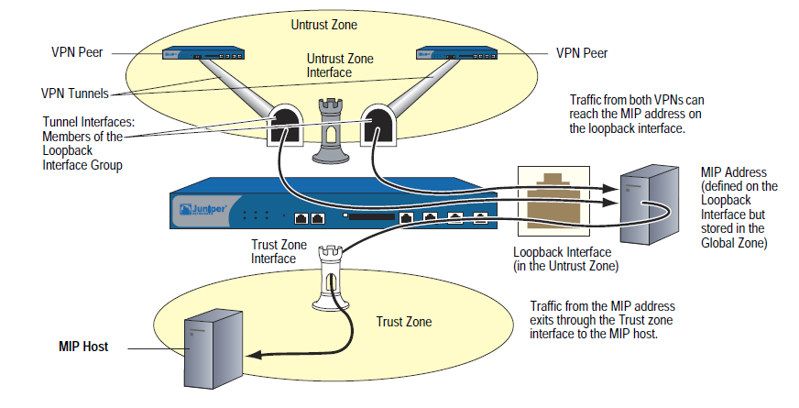
MIP and the Loopback Interface
Loopback group
Policies

Slide 81
MIP Grouping
MIP Grouping with Multi-Cell Policy
MIP Masks
  A mask specifies which bits in the network portion of the IP address are translated

Slide 82
Which takes precedence
MIPs and VIPs override unidirectional translation
MIPs override VIPs if an overlap exists
All policy-based translation overrides interface-based translation

Slide 83
Interface-based NAT – Review
If the ingress interface is in NAT mode
  Network address and port translation (NAPT) is performed by default when traversing from Trust to Untrust
  Source IP address is translated to the egress (Untrust) IP address
  Interfaces bound to the Trust zone are in NAT mode by default
If the ingress interface is in Route mode
  No address translation is performed by default
  NAT may be performed via a policy
  Interfaces bound to any zone except Trust are in Route mode by default

Slide 84
Policy-based NAT
Translation from any zone based solely on policy, not interface configuration
Unidirectional translation
  NAT-src
  NAT-dst
  VIP
Bidirectional translation
  MIP

Slide 85
NAT-Src from a DIP Pool with PAT Enabled
Outbound address is dynamically selected from a configured pool
Port translation allows “oversubscription” -- up to 65535 private addresses per public address

Slide 86
NAT-Src from a DIP Pool with PAT Disabled
For example, a custom application might require a specific number for the source port address.
Translate the source IP address in the IP packet header to any available address in DIP pool.
Retain the original source port number in the TCP segment header or UDP datagram header.

Slide 87
NAT-Src from a DIP Pool with Address Shifting
Original Source IP Address | Translated Source IP Address
10.1.1.11 | 1.1.1.101
10.1.1.12 | 1.1.1.102
10.1.1.13 | 1.1.1.103
10.1.1.14 | 1.1.1.104
10.1.1.15 | 1.1.1.105
The security device does not support source Port Address Translation (PAT) with address shifting.

Slide 88
NAT-Src from the Egress Interface IP Address
(NAT-Src Without DIP)
Translates to egress interface IP
Port translation required

Slide 89
Introduction to NAT-Dst
Packet Flow for NAT-Dst
  Refer to slide “Packet Flow 2”
Routing for NAT-Dst

Slide 90
VIP (Virtual IPs)
Many-to-one mapping of IP addresses
  Maps individual ports to different internal IP addresses
Can only be used on interface in Untrust zone
  VIP must be in same subnet as interface address
Can be the same address as Untrust interface address

Slide 91
MIP (Mapped IPs)
One-to-one static mapping for bi-directional communication
  No port translation
MIPs are defined on the “public” interface
  MIPs can be defined on any subnet
MIPs can be defined on other than Untrust zones

Slide 92
Reaching a MIP from Different Zones
Route
Policies
  Policy 1 from X-Net to Untrust – permits routing/forwarding to IP address 1.1.1.5
  Policy 2 is existing policy – invokes MIP to translate 1.1.1.5 to 10.1.1.5

Slide 93
MIP and the Loopback Interface
Loopback group
Policies

Slide 94
MIP Grouping
MIP Grouping with Multi-Cell Policy
MIP Masks
  A mask specifies which bits in the network portion of the IP address are translated

Slide 95
Which takes precedence
MIPs and VIPs override unidirectional translation
MIPs override VIPs if an overlap exists
All policy-based translation overrides interface-based translation

Slide 96
JUNOS NAT
BASIC information
Since JUNOS 9.5 NAT uses a separate policy (a.k.a. NAT-ng)
The Hierarchy for this is under "set security nat ...."
Older JUNOS Documentation and OJSE Training Materials might still mention the previous method (policy based NAT)
Destination NAT often requires additional Proxy-ARP rules
Limitations in the number of NAT rules did exist, but finally even the last (8 rules for destination NAT) disappeared with 10.2.
See http://kb.juniper.net/KB14149
We have a good Application Note on NAT
http://www.juniper.net/us/en/products-services/security/srx-series/#literature

Slide 97
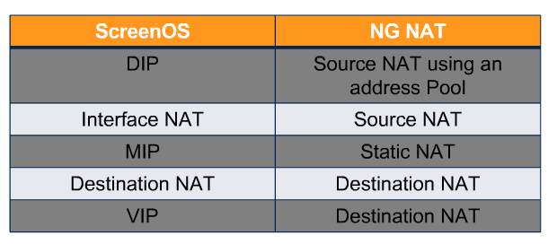
SCREENOS NAT FEATURES and JUNOS Counterpart
For Details and Examples see the Application Note
"Juniper Networks SRX Series and J Series NAT for ScreenOS Users"
http://www.juniper.net/us/en/products-services/security/srx-series/#literature
97

Slide 98
NAT
Configuration INCLUDES 3 Flavors
Source NAT
  Interface based NAT
  Pool based NAT- with and without port translation
  IP address shifting
Destination NAT
  Destination IP and/or port number translation
  IP address shifting
Static NAT
  Bi-directional
  No port translation supported
  dst-xlate for packets to the host
  src-xlate for packets initiated from the host
98

Slide 99
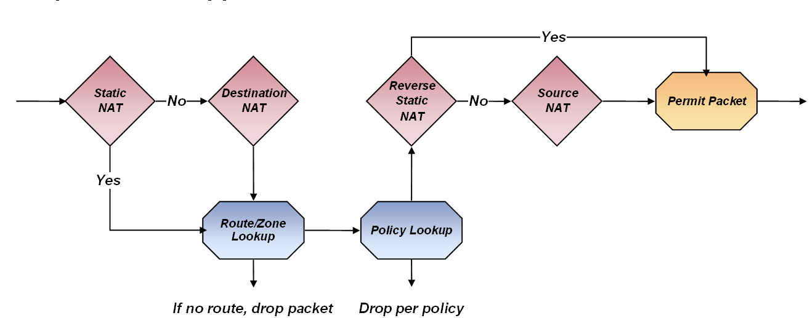
NAT
Processing ORDER
Static & Destination NAT are performed before security policies are applied
Reverse Static & Source NAT are performed after security policies are applied
Accordingly, policies always refer to the actual address of the endpoints

Slide 100
NAT
Address Pool Configuration
[edit security nat source]
root# show
pool src-nat-pool1 {
address {
192.0.0.10/32 to 192.0.0.24/32;
}
}
pool src-nat-pool2 {
address {
192.0.0.100/32 to 192.0.0.249/32;
}
port no-translation;
overflow-pool interface;
}
pool src-nat-pool3 {
address {
192.0.0.25/32;
}
}
pool src-nat-pool4 {
address {
192.0.0.50/32 to 192.0.0.59/32;
}
port range 5000 to 6000;
Address pools can be
  Single IP address
  Range of addresses
  Range of ports
  Interface (source NAT only)
  No port translation
Overflow pools
  Configured as a fall back
  Requires pools with no port translation
Notes:
100

Slide 101



Source NAT - TWO examples
[edit security nat source]
}
rule-set nat-internet {
from zone trust;
to zone untrust;
rule rule1 {
match {
source-address 0.0.0.0/0;
destination-address 0.0.0.0/0;
}
then {
source-nat interface
}
TRUST
UNTRUST
10.1.1.0/24
ge-0/0/0
INTERNET
192.1.1.0/24
[edit security nat source]
}
rule-set nat-internet {
from zone trust;
to zone untrust;
rule rule1 {
match {
source-address 0.0.0.0/0;
destination-address 0.0.0.0/0;
}
then {
source-nat pool src-nat-pool1
}
ge-0/0/1
10.1.2.0/24

Slide 102
Source NAT example WITH Multiple rules
TRUST
UNTRUST
10.1.1.0/24
ge-0/0/0
INTERNET
10.1.2.0/24
ge-0/0/1
192.1.1.0/24
rule rule2 {
match {
source-address 192.1.1.0/24;
}
then {
source-nat pool src-nat-pool2;
}
}
rule rule3 {
match {
source-address 172.1.1.0/24;
}
then {
source-nat off;
}
}
172.1.1.0/24
[edit security nat source]
}
rule-set nat-internet {
from zone trust;
to zone untrust;
rule rule1 {
match {
source-address [ 10.1.1.0/24 10.1.2.0/24 ];
destination-address 0.0.0.0/0;
}
then {
source-nat pool src-nat-pool1;
}
}

Slide 103

Destination NAT example FOR Many-to-many
TRUST
[edit security nat destination]
root# show
pool dnat-pool-1 {
address 192.168.1.100/32;
}
pool dnat-pool-2 {
address 192.168.1.200/32 port 8000;
}
rule-set dst-nat {
from zone untrust;
rule rule1 {
match {
destination-address 1.1.1.100/32;
}
then {
destination-nat pool dnat-pool-1;
}
}
rule rule2 {
match {
destination-address 1.1.1.101/32;
}
then {
destination-nat pool dnat-pool-2;
}
}
}
UNTRUST
10.1.1.0/24
ge-0/0/0
INTERNET
10.1.2.0/24
ge-0/0/1
192.1.1.100/24
192.1.1.200/24
dnat-pool-1:
1:1.1.1.100/80->192.168.1.100/80
dnat-pool-2:
1.1.1.101/80->192.168.1.200/8000

Slide 104
Destination NAT example FOR One-to-many
TRUST
[edit security nat destination]
root# show
pool dnat-pool-1 {
address 192.168.1.100/32;
}
pool dnat-pool-2 {
address 192.168.1.200/32 port 8000;
}
rule-set dst-nat {
from zone untrust;
rule rule1 {
match {
destination-address 1.1.1.100/32;
destination-port 80;
}
then {
destination-nat pool dnat-pool-1;
}
}
rule rule2 {
match {
destination-address 1.1.1.100/32;
destination-port 8000;
}
then {
destination-nat pool dnat-pool-2;
}
UNTRUST
10.1.1.0/24
ge-0/0/0
INTERNET
10.1.2.0/24
ge-0/0/1
192.1.1.100/24
192.1.1.200/24
dnat-pool-1
1.1.1.100/80->192.168.1.100/80
dnat-pool-2
1.1.1.100/8000->192.168.1.200/8000

Slide 105
Static NAT
Provides one-to-one mapping of hosts or subnets
Bi-directional NAT
  dst-xlate for packets to the host
  src-xlate for packets initiated from the host
[edit security nat]
root# show static
rule-set static-nat {
from zone untrust;
rule rule1 {
match {
destination-address 1.1.1.200/32;
}
then {
static-nat prefix 192.168.1.200/32;
}
}
TRUST
UNTRUST
10.1.1.0/24
ge-0/0/0
INTERNET
10.1.2.0/24
ge-0/0/1
192.1.1.200/24

Slide 106

Proxy-ARP
10.1.1.0/24
INTERNET
ge-0/0/0
ge-0/0/1
1.1.1.1/24
Source NAT
  Proxy-ARP required for all source IP pool addresses in the same subnet as egress interface –ge-0/0/0
  For source pools not in the same subnet as egress interface IP, route to the IP pool subnet with the SRX device as next-hop is required on the upstream router
Destination/Static NAT
  Proxy-ARP required for all IP pool addresses in the same subnet as ingress interface –ge-0/0/0
  For static and destination NAT pools not in the same subnet as egress interface IP, route to the IP pool subnet with the SRX device as next-hop is required on the upstream router
Configuration command
  set security nat proxy-arp interface <if_name> address <ip_prefix>
10.1.2.0/24

Slide 107

Double NAT- Source and Destination NAT
TRUST
UNTRUST
192.168.1.3->1.1.1.100
1.1.1.10-> 10.1.1.100
192.168.1.3/24
10.1.1.100/24
[edit security nat source]
root# show
pool src-pool-1 {
address {
1.1.1.10/32 to 1.1.1.14/32;
}
}
rule-set src-rs1 {
from zone trust;
to zone untrust;
rule r1 {
match {
source-address 0.0.0.0/0;
}
then {
source-nat pool src-pool-1;
}
}
[edit security nat destination]
root# show
pool dst-src-pool-1 {
address 10.1.1.100/32;
}
rule-set dst-rs1 {
from zone trust;
rule rule1 {
match {
destination-address 1.1.1.100/32;
}
then {
destination-nat pool dst-src-pool-1;
}
}
}

