Slide 1
Introduction to TCP/IP networking
Mircho Mirchev

Slide 2
TCP/IP protocol family
IP : Internet Protocol
  UDP : User Datagram Protocol
    RTP, traceroute
  TCP : Transmission Control Protocol
    HTTP, FTP, ssh
  others
    IP proto numbers – 0-255

Slide 3
What is an internet?
A set of interconnected networks
The Internet is the most famous example
Networks can be completely different
  Ethernet, ATM, modem, …
  (TCP/)IP is what links them

Slide 4
What is an internet? (cont)
Routers (nodes) are devices on multiple networks that pass traffic between them
Individual networks pass traffic from one router or endpoint to another
TCP/IP hides the details as much as possible

Slide 5
ISO/OSI Network Model
Seven network “layers”
  Layer 1 : Physical – cables
  Layer 2 : Data Link – ethernet
  Layer 3 : Network – IP
  Layer 4 : Transport – TCP/UDP
  Layer 5 : Session
  Layer 6 : Presentation
  Layer 7 : Application

Slide 6
TCP/IP Network Model
Different view – 4 layers
  Layer 1 : Link (we did not look at details)
  Layer 2 : Network
  Layer 3 : Transport
  Layer 4 : Application

Slide 7
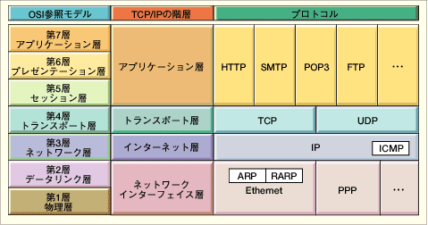
OSI and Protocol Stack
OSI: Open Systems Interconnect
OSI Model
TCP/IP Hierarchy
Protocols
7th
Application Layer
6th
Presentation Layer
Application Layer
5th
Session Layer
4th
Transport Layer
Transport Layer
3rd
Network Layer
Network Layer
2nd
Link Layer
Link Layer
1st
Physical Layer
Link Layer : includes device driver and network interface card
Network Layer : handles the movement of packets, i.e. Routing
Transport Layer : provides a reliable flow of data between two hosts
Application Layer : handles the details of the particular application

Slide 8
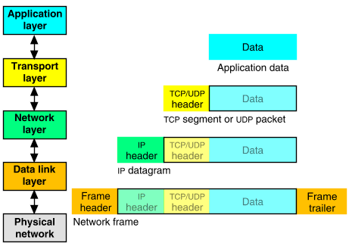
Packet Encapsulation
The data is sent down the protocol stack
Each layer adds to the data by prepending headers
22Bytes
20Bytes
20Bytes
4Bytes
64 to 1500 Bytes

Slide 9
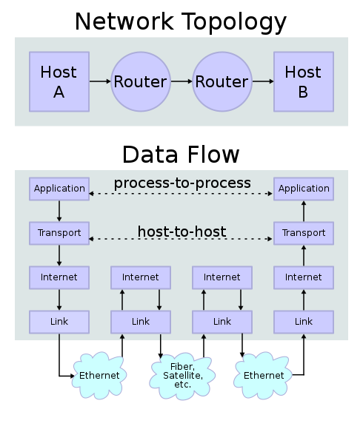
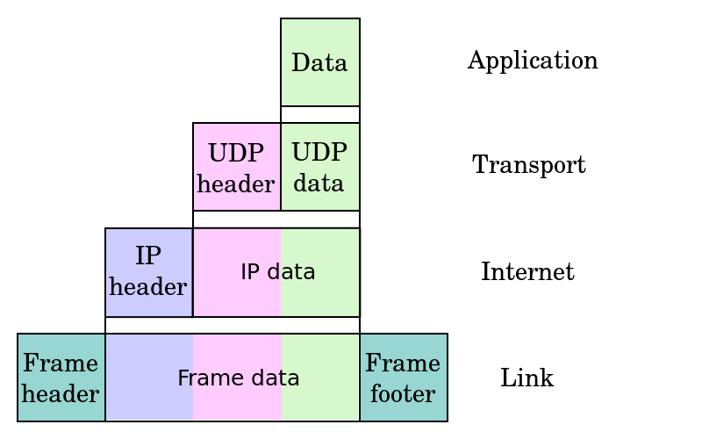
Data flow and encapsulation

Slide 10
TCP/IP
A full suite of protocols spanning layers 2 (Datalink) through 7 (Application)
Informally named for “Transmission Control Protocol” (Layer 4 - Transport) and “Internet Protocol” (Layer 3 - Network), it is comprised of many protocols

Slide 11
MAJOR Layer Associations
Datalink
Ethernet
PPP
MAC
DSL
ISDN
FDDI
L2TP (L2 Tunneling protocol)
ARP (Address Resolution Protocol)
NDP (Neighbor Discovery Protocol)
RARP (Reverse ARP)
IARP (Inverse ARP)

Slide 12
MAJOR Layer Associations
Network
IP (Internet Protocol)
IPv6 (IP Version 6)
ICMP/ICMPv6 (Internet Control Message Protocol – e.g., “ping”)
RIPv6 (Routing Information Protocol)
OSPF (Open Shortest Path First)
Others…

Slide 13
MAJOR Layer Associations
Transport
TCP (Transmission Control Protocol) – Reliable, in-sequence delivery of data, connection oriented
UDP (User Datagram Protocol) – Connectionless, delivery and sequence not guaranteed
RUDP (Reliable UDP)
BGP (Border Gateway Protocol)
SCTP (Stream Control Transmission Protocol)
Others…

Slide 14
MAJOR Layer Associations
Session
DNS (Domain Name Service)
LDAP (Lightweight Directory Access Protocol)
Others…
Presentation
LPP (Lightweight Presentation Protocol)

Slide 15
MAJOR Layer Associations
Application
FTP (File Transfer Protocol)
SNMPvX (Simple Network Management Protocol, versions 1-3)
POP3 (Post Office Protocol, version 3)
SMTP (Simple Mail Transfer Protocol)
Telnet
DHCP (Dynamic Host Configuration Protocol)
HTTP (HyperText Transfer Protocol)
Others…
(Only underlined protocols will be discussed further.)

Slide 16
Net+OS Provides…
Transport
Session
TCP (thru Sockets)
UDP (thru Sockets/Fast Sockets & “Fast IP”)
DNS
Application
DHCP
SNMP Agent
FTP Client & Server
Telnet Client
HTTP/Advanced Web Servers
Email (POP3/SMTP) Clients

Slide 17
IP
Responsible for end to end transmission
Sends data in individual packets
Maximum size of packet is determined by the networks
  Fragmented if too large
Unreliable
  Packets might be lost, corrupted, duplicated, delivered out of order

Slide 18
IP packets
Source and destination addresses
Protocol number
  1 = ICMP, 6 = TCP, 17 = UDP
Various options
  e.g. to control fragmentation
Time to live (TTL)
  Prevent routing loops

Slide 19
IPv4 in Practice
Header fields in Network Byte Order
Capable (when allowed) of fragmentation and reassembly
Packet (datagram) format:
0 16 32
Ver (4)
IHL(4)
Service(8)
Total Length (bytes) (16)
Identification (16)
CF(3)
Fragment Offset (13)
TTL(8)
Protocol (8)
Header Checksum (16)
Source IP Address (32)
Destination IP Address (32)
Options + Padding
Data (e.g., TCP Packet) (varies)

Slide 20
IP Header Fields Explained
Ver – version of IP
IHL – Internet Header Length (32-bit words)
Service – Precedence/Delay/Throughput/Reliability
Identification – assistance in reassembling fragments
CF – control flags:
  Reserved
  1 to prevent fragmentation, else 0
  1 if last fragment, else 0
Fragment Offset – of this fragment in total message, bytes
TTL – Time to Live, upper limit of life enroute
Protocol – next higher protocol, e.g., TCP, UDP or ICMP

Slide 21
IP addresses
4 bytes
  e.g. 163.1.125.98
  Each device normally gets one (or more)
  In theory there are about 4 billion available
But…

Slide 22
Allocation of addresses
Controlled centrally by ICANN
  Fairly strict rules on further delegation to avoid wastage
    Have to demonstrate actual need for them
Organizations that got in early have bigger allocations than they really need

Slide 23
Routing
How does a device know where to send a packet?
  All devices need to know what IP addresses are on directly attached networks
  If the destination is on a local network, send it directly there

Slide 24
Routing (cont)
If the destination address isn’t local
  Most non-router devices just send everything to a single local router
  Routers need to know which network corresponds to each possible IP address

Slide 25
UDP
Thin layer on top of IP
Adds packet length + checksum
  Guard against corrupted packets
Also source and destination ports
  Ports are used to associate a packet with a specific application at each end
Still unreliable:
  Duplication, loss, out-of-orderness possible

Slide 26
UDP in Practice
Connectionless protocol
Delivery and sequence not guaranteed
“Rides on” IP
Header fields in Network Byte Order Packet (datagram) format:
0 16 32
Source Port (16 bits)
Destination Port (16 bits)
Length (16 bits)
Checksum (16 bits)
Payload (varies)

Slide 27
UDP datagram
0
16
31
Source Port
Destination Port
Length
Checksum
Application data
Field Purpose
Source Port 16-bit port number identifying originating application
Destination Port 16-bit port number identifying destination application
Length Length of UDP datagram (UDP header + data)
Checksum Checksum of IP pseudo header, UDP header, and data
Notes:
21

Slide 28
Typical applications of UDP
  Where packet loss etc is better handled by the application than the network stack
  Where the overhead of setting up a connection isn’t wanted
VOIP
NFS – Network File System
Most games

Slide 29
TCP
Reliable, full-duplex, connection-oriented, stream delivery
  Interface presented to the application doesn’t require data in individual packets
  Data is guaranteed to arrive, and in the correct order without duplications
    Or the connection will be dropped
  Imposes significant overheads

Slide 30
TCP in Practice
Connection-oriented
In-sequence delivery guaranteed
“Rides” on IP
Header Fields in Network Byte Order
Packet format:
0 16 32
Source Port (16)
Destination Port (16)
Sequence Number of First Data Octet (32)
Next Expected Ack Number (32)
Ofst(4)
Rsvd(6)
Flags(6)
Window (16)
Checksum (16)
Urgent Data Pointer (16)
Options + Pad (varies)
Payload (varies)

Slide 31
TCP Segment
0
4
10
16
19
24
31
Source Port
Destination Port
Sequence Number
Acknowledgment Number
Len
Reserved
Flags
Window
Checksum
Urgent Pointer
Options...
Padding
Data...
Field Purpose
Source Port Identifies originating application
Destination Port Identifies destination application
Sequence Number Sequence number of first octet in the segment
Acknowledgment # Sequence number of the next expected octet (if ACK flag set)
Len Length of TCP header in 4 octet units
Flags TCP flags: SYN, FIN, RST, PSH, ACK, URG
Window Number of octets from ACK that sender will accept
Checksum Checksum of IP pseudo-header + TCP header + data
Urgent Pointer Pointer to end of “urgent data”
Options Special TCP options such as MSS and Window Scale
You just need to know port numbers, seq and ack are added
Notes:
27

Slide 32
TCP Header Fields Explained
Ofst - Data offset/length of header in 32-bit words
Rsvd - Reserved
Flags
  Urgent Data Pointer Significant (URG)
  Ack Field Significant (ACK)
  Reset Connection (RST)
  Push Function (PSH) – prompt forwarding
  Synchronize Sequence Numbers (SYN) – seq # is initial
  No More Data (FIN)
Window - number of octets sender will accept
Option - one octet OR one octet type + one octet length + n octets option information

Slide 33
Applications of TCP
Most things!
  HTTP, FTP, …
Saves the application a lot of work, so used unless there’s a good reason not to

Slide 34
TCP implementation
Connections are established using a three-way handshake
Data is divided up into packets by the operating system
Packets are numbered, and received packets are acknowledged
Connections are explicitly closed
  (or may abnormally terminate)

Slide 35
TCP Packets
Source + destination ports
Sequence number (used to order packets)
Acknowledgement number (used to verify packets are received)

Slide 36
TCP : Data transfer
Client
Host
Send Packet 1
Start Timer
Packet Lost
Timer
Packet should arrive
ACK should be sent
ACK would normally
Arrive at this time
Time Expires
Retransmit Packet1
Start Timer
Timer
Receive Packet 1
Send AXK 1
Receive ACK 1
Cancel Timer

