Slide 1
IPv6 Intro Part 1: Overview and Addressing Basics
Notes:
This is the first of 2 PowerPoint presentations that introduce IPv6. The two presentations combined provide information on the purpose and benefits of IPv6 as well as an explanation of the addressing structure.
NOTE: Most of the slides have notes to provide additional detail and background information for student handouts if desired and these can also be used as lecture points by the instructor.

Slide 2
Objectives
Describe IPv4 issues and workarounds.
Describe IPv6 features and benefits.
Describe the IPv6 header structure.
Describe the basics of IPv6 addressing.
Notes:
The objectives of this lesson are to provide background on the shortcomings of IPv4, workarounds that have been employed, and the improved features offered by IPv6. This lesson also describes the simplified IPv6 packet header structure and introduces IPv6 addressing which is covered in greater detail in IPv6 Intro Part 2.

Slide 3

IPv4 Issues and IPv6 Benefits
Notes:
This section describes the issues associated with IPv4 and the workarounds implemented to compensate for them. The primary focus is on the features and benefits of IPv6.

Slide 4
The Motivation for Moving to IPv6
The ability to scale networks for future demands requires a large supply of IP addresses and improved mobility.
  IPv6 combines expanded addressing with a more efficient header.
  IPv6 satisfies the complex requirements of hierarchical addressing.
Notes:
To provide the address space needed and scale for future Internet growth, IPv6 is the answer.
IPv6 combines expanded addressing with a more efficient and feature-rich header to meet these demands.
While it has many similarities to IPv4, IPv6 satisfies the increasingly complex requirements of hierarchical addressing that IPv4 does not support.

Slide 5
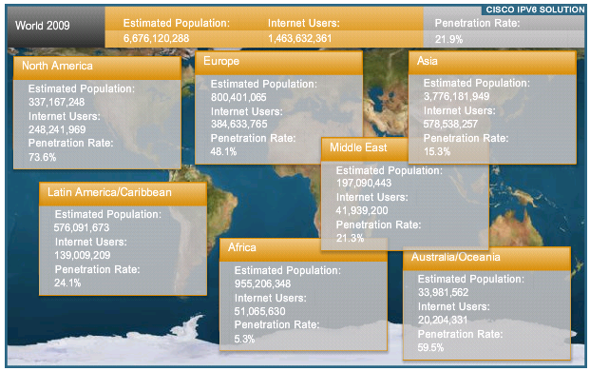
The Internet Is Growing …
In 2009, only 21% of the world population was connected.
Notes:
The Internet is growing rapidly. As of 2009, Africa, with a population of nearly one billion, had a penetration rate of only 5.3 percent. The adoption rate worldwide will continue to increase as underdeveloped countries get connected.
In a recent interview with Cisco CEO John Chambers, he is quoted as saying:
“The continuous growth of the global Internet requires that its overall architecture evolve to accommodate new technologies to support the growing numbers of users, applications, appliances, and services. Due to market dynamics and exhaustion of the IPv4 address space, every customer in the market will face the inevitable transition from IPv4 to IPv6.”

Slide 6
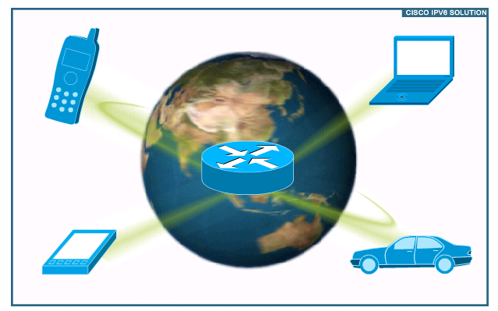
  Explosion of New IP-Enabled Devices
Notes:
More and more IP-enabled devices are connecting to the Internet. Devices include cell phones, consumer products (blue ray players, TVs), surveillance and transportation communication systems.

Slide 7
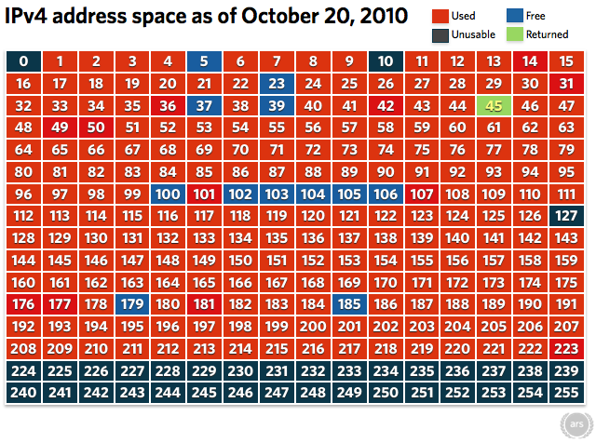
IPv4 Address Depletion
Notes:
All of this growth is causing the Internet to run out of public IPv4 addresses.
This chart shows the state of IPv4 address assignment as of October 20th, 2010. Each block in the chart is a slash (/)8, each of which represents over 16 million addresses.
The red address blocks are IPv4 addresses that are already assigned.
The black address blocks are multicast and other reserved addresses that are unavailable.
The blue address blocks are the remaining addresses available for assignment.
The green 45.x.x.x/8 address block was previously owned by Interop, the sponsors of the major annual international networking conference. They recently returned the bulk of these 16+ million address to the pool of available addresses. These are now available for assignment but won’t last for long!
NOTE: The full article on Interop is at: http://arstechnica.com/business/news/2010/10/embargoed-interop-gives-back-a-months-worth-of-ipv4-addresses.ars

Slide 8
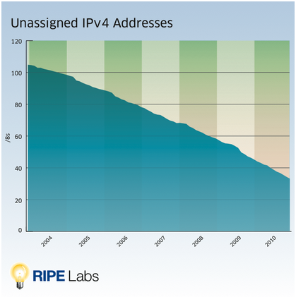
IPv4 Address Depletion
NAT, VLSM and CIDR were developed as workarounds and have helped to extend the life of IPv4.
In October 2010, less than 5% of the public IPv4 addresses remained unallocated.
Notes:
Extensions to IPv4 including Network Address Translation (NAT), variable length subnet masks (VLSM) and classless inter-domain routing (CIDR) have helped to extend the life of IPv4. NAT in particular has been a major factor in slowing the depletion of addresses.
Despite these efforts, as of October 2010, less than 5% of the public IPv4 addresses remained unallocated.
Although estimates vary, this pool may be exhausted by early 2012.
As emerging nations and new ISPs come online, they will not be able to obtain blocks of IPv4 addresses. Although stop-gap measures such as NAT exist, the ultimate solution is IPv6.

Slide 9
Other IPv4 Issues
Internet routing table expansion
Lack of true end-to-end model due to NAT
Notes:
The Internet routing tables continue to grow which means Internet core routers require more processing power, memory, and overhead.
IPv4 networks typically use NAT as the solution to address depletion. However, NAT hides the true source address of traffic, which can cause other issues.

Slide 10
What Happened to IPv5?
The Internet Stream Protocol (ST) was developed to experiment with voice, video and distributed simulation.
Newer ST2 packets used IP version number 5 in the header.
Although not officially know as IPv5, ST2 is considered to be the closest thing.
The next Internet protocol became IPv6.
Notes:
The Internet Stream Protocol (ST) was a family of experimental protocols develop in the 1970s to experiment with voice, video and distributed simulation.
ST2 was developed in the 1990s and its packets used Internet Protocol version number 5 in the header to distinguish it from IPv4.
Although not officially know as IPv5, ST2 is the closest thing to it in the evolution of the Internet
With the development work starting on IPng in 1994 it was decided to make major revisions to IPv4 and name the next Internet protocol IPv6.

Slide 11
Features and Benefits of IPv6
Larger address space
Elimination of public-to-private NAT
Elimination of broadcast addresses
Simplified header for improved router efficiency
Support for mobility and security
Many devices and applications already support IPv6
Notes:
There are a number of benefits to using IPv6:
The primary benefit of IPv6 is its larger address space.
With a 128-bit There are enough IPv6 addresses to allocate more than the entire IPv4 Internet address space to everyone on the planet.
This larger address space allows end-to-end communication without public-to-private address translation.
IPv6 does not have broadcast addresses which helps reduce excessive network communication. IPv6 address types will be covered in greater detail later.
Another benefit is the simplified IPv6 header which allows for improved router efficiency and forwarding performance.
IPv6 support for mobility and security help ensure compliance with mobile IP and IPsec standards.
Many devices and applications already support IPv6. This includes extensive Cisco device IOS support and workstation/server operating system support such as that found in Windows and Linux.

Slide 12
Features and Benefits of IPv6 - Continued
Prefix renumbering simplified
Multiple addresses per interface
Address autoconfiguration
  No requirement for DHCP
Link-local and globally routable addresses
Multiple-level hierarchy by design
  More efficient route aggregation
Transition mechanisms from IPV4 to IPV6
Notes:
Additional features of IPv6 include:
Simplified mechanisms, which are available for address and prefix renumbering, if required.
In addition, multiple addresses are allowed on an IPv6 interface without the limitations and drawbacks associated with IPv4.
To help reduce administrative burden, IPv6 devices can configure their own interfaces using address autoconfiguration. This facilitates Plug and Play networking with a wide variety of devices and there is no requirement for DHCP.
Although stateless autoconfiguration can satisfy most IPv6 addressing needs, DHCPv6 is available and can still be used to assign addresses statefully if the network administrator desires more control over addressing.
IPv6 link-local addresses are used as the next hop when IGPs are exchanging routing updates and can be automatically configured.
IPv6 addressing is a multiple-level hierarchy by design and allows for more efficient route aggregation.
To facilitate migration from IPv4 to IPv6, a number of transition mechanisms are available including dual-stack, tunneling and protocol translation. These will be covered in another presentation.

Slide 13
Who is Using IPv6?
Governments
Corporations
Universities
Internet Service Providers
Google
Facebook
Notes:
A number of organizations are already using IPv6. These include governments, corporations, universities and Internet providers. They operate on Internet 2 or the IPv6 Internet.
As an example of the importance placed on the transition to IPv6 by the US government, here is an excerpt from a Federal Chief Information Office (CIO) memo dated September 28th, 2010: “In order to facilitate timely and effective IPv6 adoption, agencies shall: Upgrade public/external facing servers and services (e.g. web, email, DNS, ISP services, etc.) to operationally use native IPv6 by the end of fiscal year 2012.”
Other examples of the move toward IPv6:
In the Beijing 2008 Summer Olympic Games, all network operations of the Games were conducted using IPv6. This event was reported to be the largest showcase of IPv6 technology since the inception of IPv6.
In January 2009, Google extended its IPv6 initiative with Google over IPv6.
In June 2010, Facebook became accessible on IPv6 via http://www.v6.facebook.com

Slide 14
IP Address Space Allocated to ARIN
IPv6 Allocation Blocks
  2001:0400::/23
  2001:1800::/23
  2001:4800::/23
  2600:0000::/12
  2610:0000::/23
  2620:0000::/23
Notes:
Internet Assigned Numbers Authority (IANA) coordinates the global IPv4, IPv6 and autonomous system (AS) number space, and allocates these to Regional Internet Registries (RIRs).
IANA has allocated the address blocks shown here to the American Registry for Internet Numbers (or ARIN) for allocation and assignment within its region.
Information on all IP address blocks that IANA has assigned is available at: www.iana.org.

Slide 15
IPv6 Prefix Allocation Hierarchy and Policy Example
IANA
2001::/3
AfriNIC
::/12 to::/23
APNIC
::/12 to::/23
ARIN
::/12 to::/23
LACNIC
::/12 to::/23
RIPE NCC
::/12 to::/23
ISP
/32
ISP
/32
ISP
/32
ISP
/32
ISP
/32
ISP
/32
ISP
/32
ISP
/32
ISP
/32
ISP
/32
ISP
/32
ISP
/32
ISP
/32
ISP
/32
ISP
/32
Site
/48
Site
/48
Site
/48
Site
/48
Site
/48
Site
/48
Site
/48
Site
/48
Site
/48
Site
/48
Site
/48
Site
/48
Site
/48
Site
/48
Site
/48
Notes:
IPv6 address space is allocated in a hierarchical manner as shown here:
IANA allocates from the total 2001::/3 global IPv6 unicast address space to regional registries such as APNIC and RIPE.
Each regional registry gets a /23 prefix from IANA (although a larger address space can be requested).
The registry typically allocates a /32 prefix to an IPv6 ISP.
Then the ISP allocates a /48 prefix to each customer (or potentially /64 for a local network or /128 for a single host).

Slide 16
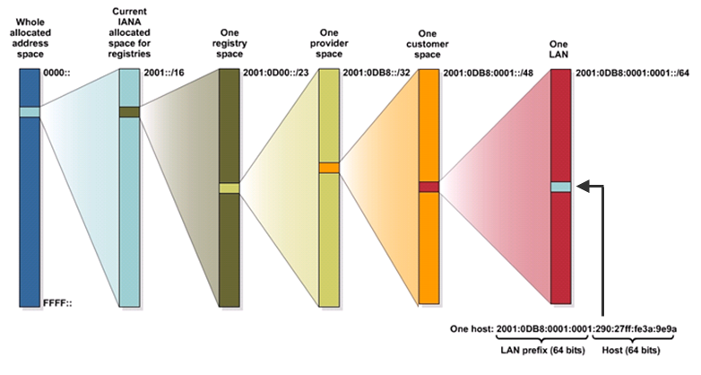
IPv6 Address Allocation Process
Notes:
This graphic depicts the address allocation process starting with the entire IPv6 global unicast address space and ending with a single 128-bit IPv6 address for a host on a LAN.

Slide 17
Is IPv4 Obsolete?
IPv4 is in no danger of disappearing overnight.
It will coexist with IPv6 and then gradually be replaced.
IPv6 provides several transition options including:
  Dual stack
  Tunneling mechanisms
  NAT-PT (Deprecated)
Notes:
IPv4 will be with us for a long time but we are rapidly running out of addresses and IPv4 will eventually be replaced.
Several IPv4-to-IPv6 transition options are available; these include:
Dual stack, where both IPv4 and IPv6 are configured and run simultaneously on an interface.
Tunneling mechanisms such as manual IPv6, dynamic 6to4 and ISATAP
NAT protocol translation (NAT-PT) between IPv6 and IPv4 devices.
NOTE: Although NAT-PT (defined RFC 2766) is listed as a transition option here for completeness, it is important to note that, due to numerous issues, it has been obsoleted by RFC 4966 and deprecated to historic status.

Slide 18
Where is IPv6 Covered In CCNA?
Discovery Series
Networking for Home and Small Businesses
  No coverage
Working at a Small-to-Medium Business or ISP
  4.1.6
Introducing Routing and Switching in the Enterprise
  5.2.1
Designing and Supporting Computer Networks
  6.3
Exploration Series
Network Fundamentals
  6.3.6
Routing Protocols and Concepts
  1.1.3, 3.1.1, 5.1.1, 10.2.3, 11.1.1, 11.7.1
LAN Switching and Wireless
  no coverage
Accessing the WAN
  7.0.1, 7.3, 7.5.1
Notes:
With the current CCNA curriculum, IPv6 is discussed in three of the four Discovery courses (Discovery 2, 3 and 4) and three of the four Exploration courses (Exploration 1, 2 and 4).

Slide 19

IPv6 Header Structure
Notes:
This section describes the simplified header structure of the IPv6 packet and its advantages over the IPv4 header.

Slide 20
IPv6 Header Improvements
Improved routing efficiency
No requirement for processing checksums
Simpler and more efficient extension header mechanisms
Flow labels for per-flow processing
Notes:
The simplified IPv6 header provides several advantages over IPv4:
Routing efficiency is improved for performance and forwarding-rate scalability.
There is no requirement for processing checksums, which IPv6 leaves to the Data Link Layer and/or upper layers.
A simpler and more efficient extension header mechanism allows multiple optional extension headers in a single IPv6 packet.
Flow labels provide per-flow processing with no need to examine the transport layer information to identify the various traffic flows.

Slide 21
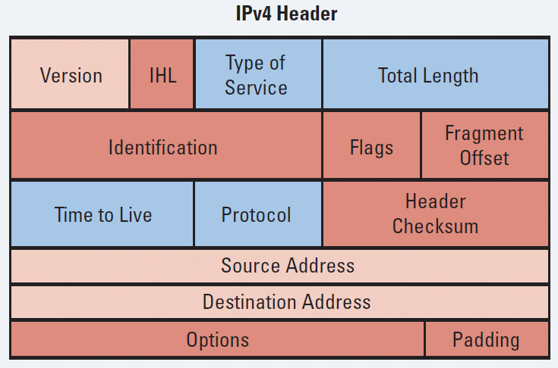
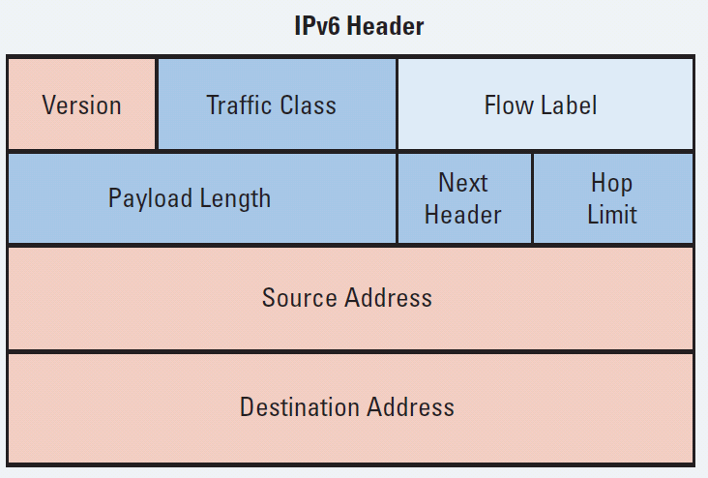
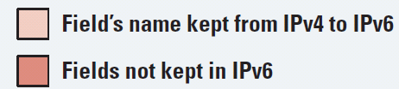
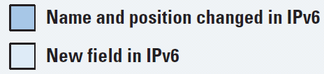
IPv4 Header vs. IPv6 Header
Notes:
This graphic compares the IPv4 and IPv6 header fields. The IPv4 header has 20 octets containing 12 basic header fields. The IPv6 header is larger at 40 octets, due primarily to the longer IPv6 addresses, but has a simpler structure with only 8 fields.
Three of these fields serve the same function and have the same name in the IPv4 and IPv6 header (Version, Source Address and Destination Address). They are identified by light pink in the graphic.
The darker blue fields serve similar functions as in IPv4, but different names.
The remaining IPv4 fields (dark pink) no longer exist in IPv6.
The flow label field (light blue) is new to IPv6.
The extension headers, if any, and the data portion of the packet follow the other eight fields.
Additional notes on IPv6 header fields:
Version—A 4-bit field, the same as in IPv4. For IPv6, this field contains the number 6; for IPv4, this field contains the number 4.
Traffic class—An 8-bit field similar to the type of service (ToS) field in IPv4. This field tags the packet with a traffic class that it uses in differentiated services (DiffServ) quality of service (QoS). These functionalities are the same for IPv6 and IPv4.
Flow label—This 20-bit field is new in IPv6. It can be used by the source of the packet to tag the packet as being part of a specific flow, allowing multilayer switches and routers to handle traffic on a per-flow basis rather than per-packet, for faster packet-switching performance. This field can also be used to provide QoS.
Payload length—This 16-bit field is similar to the IPv4 total length field.
Next header—The value of this 8-bit field determines the type of information that follows the basic IPv6 header. It can be a transport-layer packet, such as Transmission Control Protocol (TCP) or User Datagram Protocol (UDP), or it can be an extension header. The next header field is similar to the protocol field of IPv4.
Hop limit—This 8-bit field specifies the maximum number of hops that an IP packet can traverse. Similar to the time to live (TTL) field in IPv4, each router decreases this field by one. Because there is no checksum in the IPv6 header, an IPv6 router can decrease the field without recomputing the checksum; in IPv4 routers the recomputation costs processing time. If this field ever reaches 0, a message is sent back to the source of the packet and the packet is discarded.
Source address—This field has 16 octets or 128 bits. It identifies the source of the packet.
Destination address—This field has 16 octets or 128 bits. It identifies the destination of the packet.
Extension headers—The extension headers, if any, and the data portion of the packet follow the other eight fields. The number of extension headers is not fixed, so the total length of the extension header chain is variable.
Notice that the IPv6 header does not have a header checksum field. Because link-layer technologies perform checksum and error control and are considered relatively reliable, an IP header checksum is considered to be redundant. Without the IP header checksum, upper-layer checksums, such as within UDP, are mandatory with IPv6.

Slide 22
Protocol and Next Header Fields
Notes:
In IPv4 the Protocol field is used to identify the next level protocol (e.g., TCP, UDP, ICMP, …).
In IPv6, this field is called the "Next Header" field and serves the same purpose.

Slide 23
Extension Headers
The Next Header field identifies what follows the Destination Address field:
(Optional) Extension Header(s)
Data …
Notes:
Extension headers make the handling of options more efficient.
Multiple extension headers (called a chain) may be included in an IPv6 packet.
The number of extension headers is not fixed, so the total length of the extension header chain is variable.

Slide 24
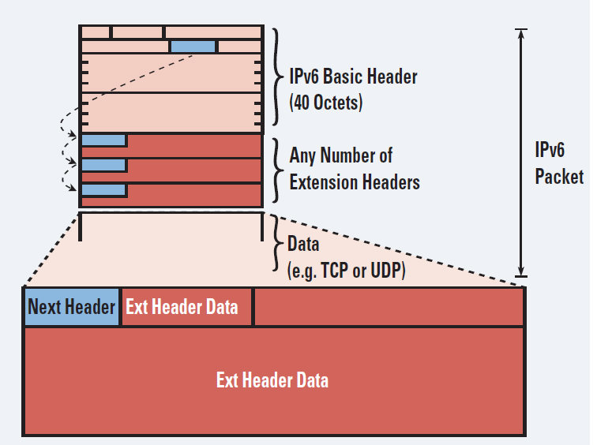
Extension Headers
The destination node examines the first extension header (if any).
Notes:
The contents of an extension header determine whether or not the node should examine the next header.
Therefore, extension headers must be processed in the order they appear in the packet.

Slide 25
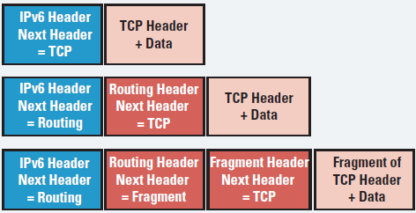
Extension Header Options
Notes:
In this graphic, the first example is a typical IPv6 packet, with only a next header of TCP plus data, and no extension headers.
The second example IPv6 packet contains a single Routing extension header.
The third example has a Routing extension header and a Fragment extension header.

Slide 26
Extension Header Chain Order
Process Order | Extension Header | Next-header value (protocol #)
1 | Hop-by-hop options header | 0
2 | Destination options header | 60
3 | Routing header | 43
4 | Fragment header | 44
5 | Authentication header (AH) and ESP header | ESP = 50 AH = 51
6 | Upper-layer header: TCP UDP | TCP = 6 UDP = 17
Notes:
When more than one extension header is used in the same packet, it is recommended that those headers appear in the order shown here.
The protocol number in the Next Header field indicates which extension header follows.

Slide 27

IPv6 Addressing Overview
Notes:
This section provides a brief introduction to the IPv6 address structure, how to abbreviate IPv6 addresses and the types of IPv6 addresses that exist.

Slide 28
IPv6 Addressing Overview
IPv6 increases the number of address bits by a factor of 4, from 32 to 128, providing a very large number of addressable nodes.
IPv4 = 32 bits
11111111.11111111.11111111.11111111
IPv6 = 128 bits
11111111.11111111.11111111.11111111 | 11111111.11111111.11111111.11111111 | 11111111.11111111.11111111.11111111 | 11111111.11111111.11111111.11111111
Notes:
With IPv4, some number of bits on the left side of the 32 bit address represent the network and possibly the subnet.
The remaining bits represent a host on that network/subnet.
With IPv6, normally the first 64 bits represent the network/subnet address and the remaining 64 bits represent the host address. This will be covered in greater detail later.

Slide 29
IPv6 Address Specifics
The 128-bit IPv6 address is written using 32 hexadecimal numbers.
The format is x:x:x:x:x:x:x:x, where x is a 16-bit hexadecimal field, therefore each x represents four hexadecimal digits.
Example address:
    2035:0001:2BC5:0000 : 0000:087C:0000:000A
Notes:
The 128-bit address consists of 8, 16-bit segments, with each 16-bit segment represented by four Hex digits.
Each of the four hex digits is represents four bits.
A colon separates each set of four hex digits.
This is referred to as the “coloned hex” format whereas IPv4 notation is referred to as “dotted decimal”.
Hex digits are not case sensitive.
Note that IPv6 addresses currently being assigned by IANA for public use begin with Hex 2001.

Slide 30
Abbreviating IPv6 Addresses
Leading 0s within each set of four hexadecimal digits can be omitted.
  09C0 = 9C0
  0000 = 0
A pair of colons (“::”) can be used, once within an address, to represent any number (“a bunch”) of successive zeros.
Notes:
IPv6 addresses can be very long and confusing to look at.
Fortunately, in many cases, they can be abbreviated by suppressing leading zeros and representing 4 consecutive zeros within a 4-character Hex field with a single zero.
A pair of colons can be used to represent consecutive Hex field strings of zeros.
This greatly simplifies the writing of IPv6 addresses since the eight 16-bit Hex fields can be compressed when there are a number of consecutive zeros in the address. This happens frequently, especially with the network portion of the address.

Slide 31
IPv6 Address Abbreviation Example
2031:0000:130F:0000:0000:09C0:876A:130B
2031:0000:130F:0000:0000:09C0:876A:130B
2031: 0:130F: 0: 0: 9C0:876A:130B
2031:0:130F:0:0:9C0:876A:130B
2031:0:130F:0:0:9C0:876A:130B
2031:0:130F::9C0:876A:130B
Notes:
This example shows how an IPv6 address can be abbreviated or compressed by converting four hex digit zeros to a single zero, elimination of leading zeros and the representation of multiple sets of contiguous zeros as a double colon.
Remember that the double colon can be used only once in an IPv6 address.

Slide 32
More IPv6 Address Abbreviation Examples
FF01:0000:0000:0000:0000:0000:0000:1
= FF01:0:0:0:0:0:0:1
= FF01::1
E3D7:0000:0000:0000:51F4:00C8:C0A8:6420
= E3D7::51F4:C8:C0A8:6420
3FFE:0501:0008:0000:0260:97FF:FE40:EFAB
= 3FFE:501:8:0:260:97FF:FE40:EFAB
= 3FFE:501:8::260:97FF:FE40:EFAB
Notes:
Shown here are some additional examples of how IPv6 addresses with leading and contiguous zeros can be abbreviated.

Slide 33
IPv6 Address Components
An IPv6 address consists of two parts:
  A subnet prefix
  An interface ID
IPv6 = 128 bits
11111111.11111111.11111111.11111111 | 11111111.11111111.11111111.11111111 | 11111111.11111111.11111111.11111111 | 11111111.11111111.11111111.11111111
Subnet prefix
Interface ID
Notes:
The subnet prefix represents the network to which the interface is connected and is usually 64 bits in length.
The interface ID (sometimes called a local identifier) is also 64 bits in length.

Slide 34
Subnet Prefix
IPv6 uses CIDR notation to denote the number of bits that represent the subnet.
Example:
FC00:0:0:1::1234/64
is really
FC00:0000:0000:0001:0000:0000:0000:1234/64
  The first 64-bits (FC00:0000:0000:0001) forms the address prefix.
  The last 64-bits (0000:0000:0000:1234) forms the Interface ID.
Notes:
IPv6 uses the slash (/) prefix-length CIDR notation to denote how many bits in the IPv6 address represent the subnet.
The syntax is ipv6-address slash (/)prefix-length, where the ipv6-address is the full 128-bit IPv6 address.
The /prefix-length is a decimal value representing how many of the left most contiguous bits of the address comprise the prefix.

Slide 35
Subnet Prefix
The prefix length is almost always /64.
  However, IPv6 rules allow for either shorter or longer prefixes
Deploying a /64 IPv6 prefix on a device recommended.
  Allows Stateless Address Auto Configuration (SLAAC)
Notes:
Deploying a /64 IPv6 prefix on a device recommended (pre-subscribed by RFC3177 (IAB/IESG Recommendations on IPv6 Address Allocations to Sites).
The major advantage to using a /64 prefix is that it allows Stateless Address Auto Configuration (SLAAC) as defined in RFC 2462.
Note that, although prefixes shorter than /64 can be assigned to a device (e.g., /60), it is considered bad practice and has no real application.

Slide 36
Interface Identifiers
IPv6 addresses on a link must be unique.
Using the link prefix length, IPv6 hosts can automatically create a unique IPv6 address.
The following Layer 2 protocols can dynamically create the IPv6 address interface ID:
    Ethernet
    PPP
    HDLC
    NBMA, Frame Relay
Notes:
IPv6 addresses on a link must be unique. Although they all share the same 64-bit subnet prefix they are made unique by the interface ID.
Because the prefix length is fixed and well-known (64 bits), IPv6 hosts can automatically create a unique IPv6 address.
The most widely used Layer 2 protocols can dynamically create the IPv6 address interface ID.
Of the protocols listed here, Ethernet is by far the most common and uses the EUI-64 format which will be discussed in IPv6 Intro Part 2.
Other popular Layer 2 protocols supported by Autoconfiguration include:
PPP
HDLC
NBMA, Frame Relay
Note that the Cisco IOS does not support autoconfiguration of IPv6 addresses with all Layer 2 protocols, only the more common ones.

Slide 37
IPv6 Address Types
Address Type | Description | Topology
Unicast | “One to One” An address destined for a single interface. A packet sent to a unicast address is delivered to the interface identified by that address.
Multicast | “One to Many” An address for a set of interfaces (typically belonging to different nodes). A packet sent to a multicast address will be delivered to all interfaces identified by that address.
Anycast | “One to Nearest” (Allocated from Unicast) An address for a set of interfaces. In most cases these interfaces belong to different nodes. created “automatically” when a single unicast address is assigned to more than one interface. A packet sent to an anycast address is delivered to the closest interface as determined by the IGP.
Notes:
There are three main groups or addresses types defined for use with IPv6.
IPv6 Unicast and Multicast addresses perform a similar function as those in IPv4.
The Anycast type of address is new to IPv6 and not widely used at this time.
Anycast can be used by routers to facilitate load sharing and provide alternate path flexibility if a router becomes unavailable. Only routers should respond to an anycast address.
Recall that with IPv6 there are no broadcasts and no broadcast addresses.

Slide 38
IPv6 Unicast Address Scopes
Address types have well-defined destination scopes:
  Link-local address
  Site-local address (replaced by Unique-local addresses)
  Global unicast address
Global
(Internet)
Site-Local
Link-Local
Note: Site-Local Address are deprecated in RFC 3879.
Notes:
There are three main categories of unicast addresses with IPv6, each of which has a different focus or scope.
These were originally defined as Link-Local, Site-Local and Global.
However, with RFC 3879, Site-Local Addresses are deprecated (not supported) and have been replaced by Unique-Local addresses.

Slide 39
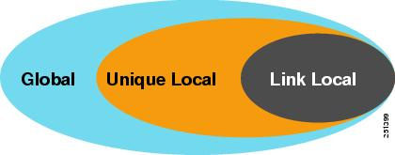
IPv6 Unicast Address Scopes
Link-local addresses—only on single link, not routed
  FE80 prefix
Unique-local addresses—routed within private network
  FC00 prefix
Global unicast addresses—globally routable
  2001 prefix most common
Notes:
Link-local addresses are only configured on a single link between two devices. They are not routed and always start with a FE80 prefix. They are commonly used for IGP routing protocol communication.
Unique-local addresses are routable, but only within a private network, they are not supported on the Internet and are not to be used with NAT. They always start with a FC00 prefix.
Global unicast addresses are globally routable on the Internet. The 2001 prefix is currently being issued by IANA for public use. Global unicast addresses always contain a 64-bit host portion. They are identified by their three high-level bits set to 001 (hex 2 or 3::/3). 0010 = 0x2 & 0011 = 0x3.
These three types of IPv6 unicast address are easily identified by their prefix.

Slide 40
Site-Local Addresses - Deprecated
Site-local addresses allowed devices in the same organization, or site, to exchange data.
  Site-local addresses start with the prefix FEC0::/10.
They are analogous to IPv4's private address classes.
    However, using them would also mean that NAT would be required and addresses would again not be end-to-end.
Site-local addresses are no longer supported (deprecated by RFC 3879).
Notes:
Site-local addresses, mentioned previously, have been deprecated.
They are analogous to IPv4's private address classes. However, using them would also mean that NAT would be required and addresses would again not be end-to-end.
Site-local addresses start with the prefix FEC0::/10 and are still commonly used in training literature.
Unique-local addresses (those in address block FC00::/7) have replaced the Site-local addresses for use with systems that are not connected to the Internet. They are routable only within a private network and are not routable in the global IPv6 Internet.

Slide 41
Multiple IPv6 Addresses per Interface
An interface can have multiple global IPv6 addresses.
Typically, an interface is assigned a link-local and one (or more) global IPv6 address.
For example, an Ethernet interface can have:
    Link-local address
    (FE80::21B:D5FF:FE5B:A408)
    Global unicast address
    (2001:8:85A3:4289:21B:D5FF:FE5B:A408)
The Link-local address is used for local device communication.
The Global address is used to provide Internet reachability.
Notes:
An interface can have multiple IPv6 global unicast addresses simultaneously configured and enabled on it. However, it must also have a single link-local address.
Typically, an interface is assigned a link-local address and one (or more) global IPv6 addresses.
Note that in the example, the Link Local address starts with Hex FE80 and the global unicast address starts with Hex 2001.
Both of these addresses were autoconfigured using the EUI-64 method which makes use of the Ethernet MAC address to create the interface ID (in this example, 21B:D5FF:FE5B:A408). Autoconfiguration and EUI-64 are covered in IPv6 Intro Part 2.
An interface could also be configured to simultaneously support IPv4 and IPv6 addresses. This creates a “dual-stacked” interface.

Slide 42
IPv6 Resources
http://ipv6.beijing2008.cn/en
http://www.iana.org/numbers/
http://www.cisco.com/go/ipv6

